Slide 1

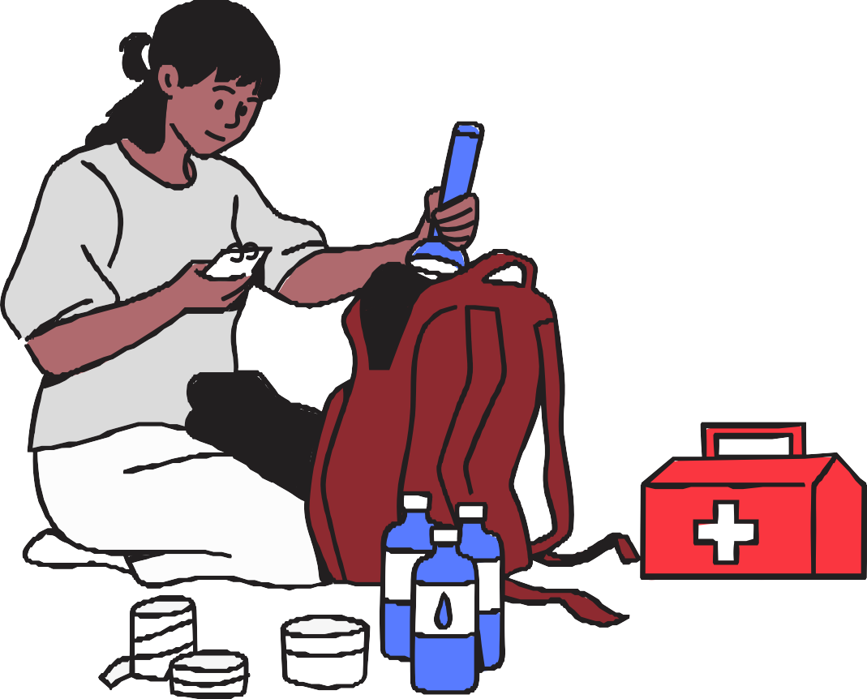

Be Ready for Anything: Preparing for Emergencies

Slide 2

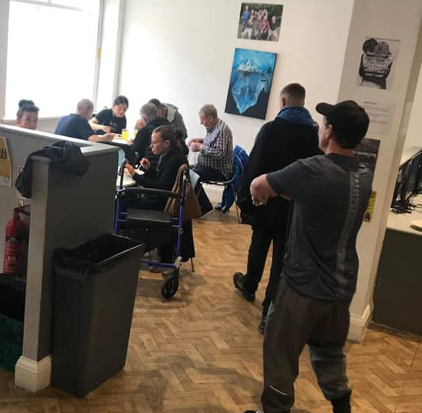
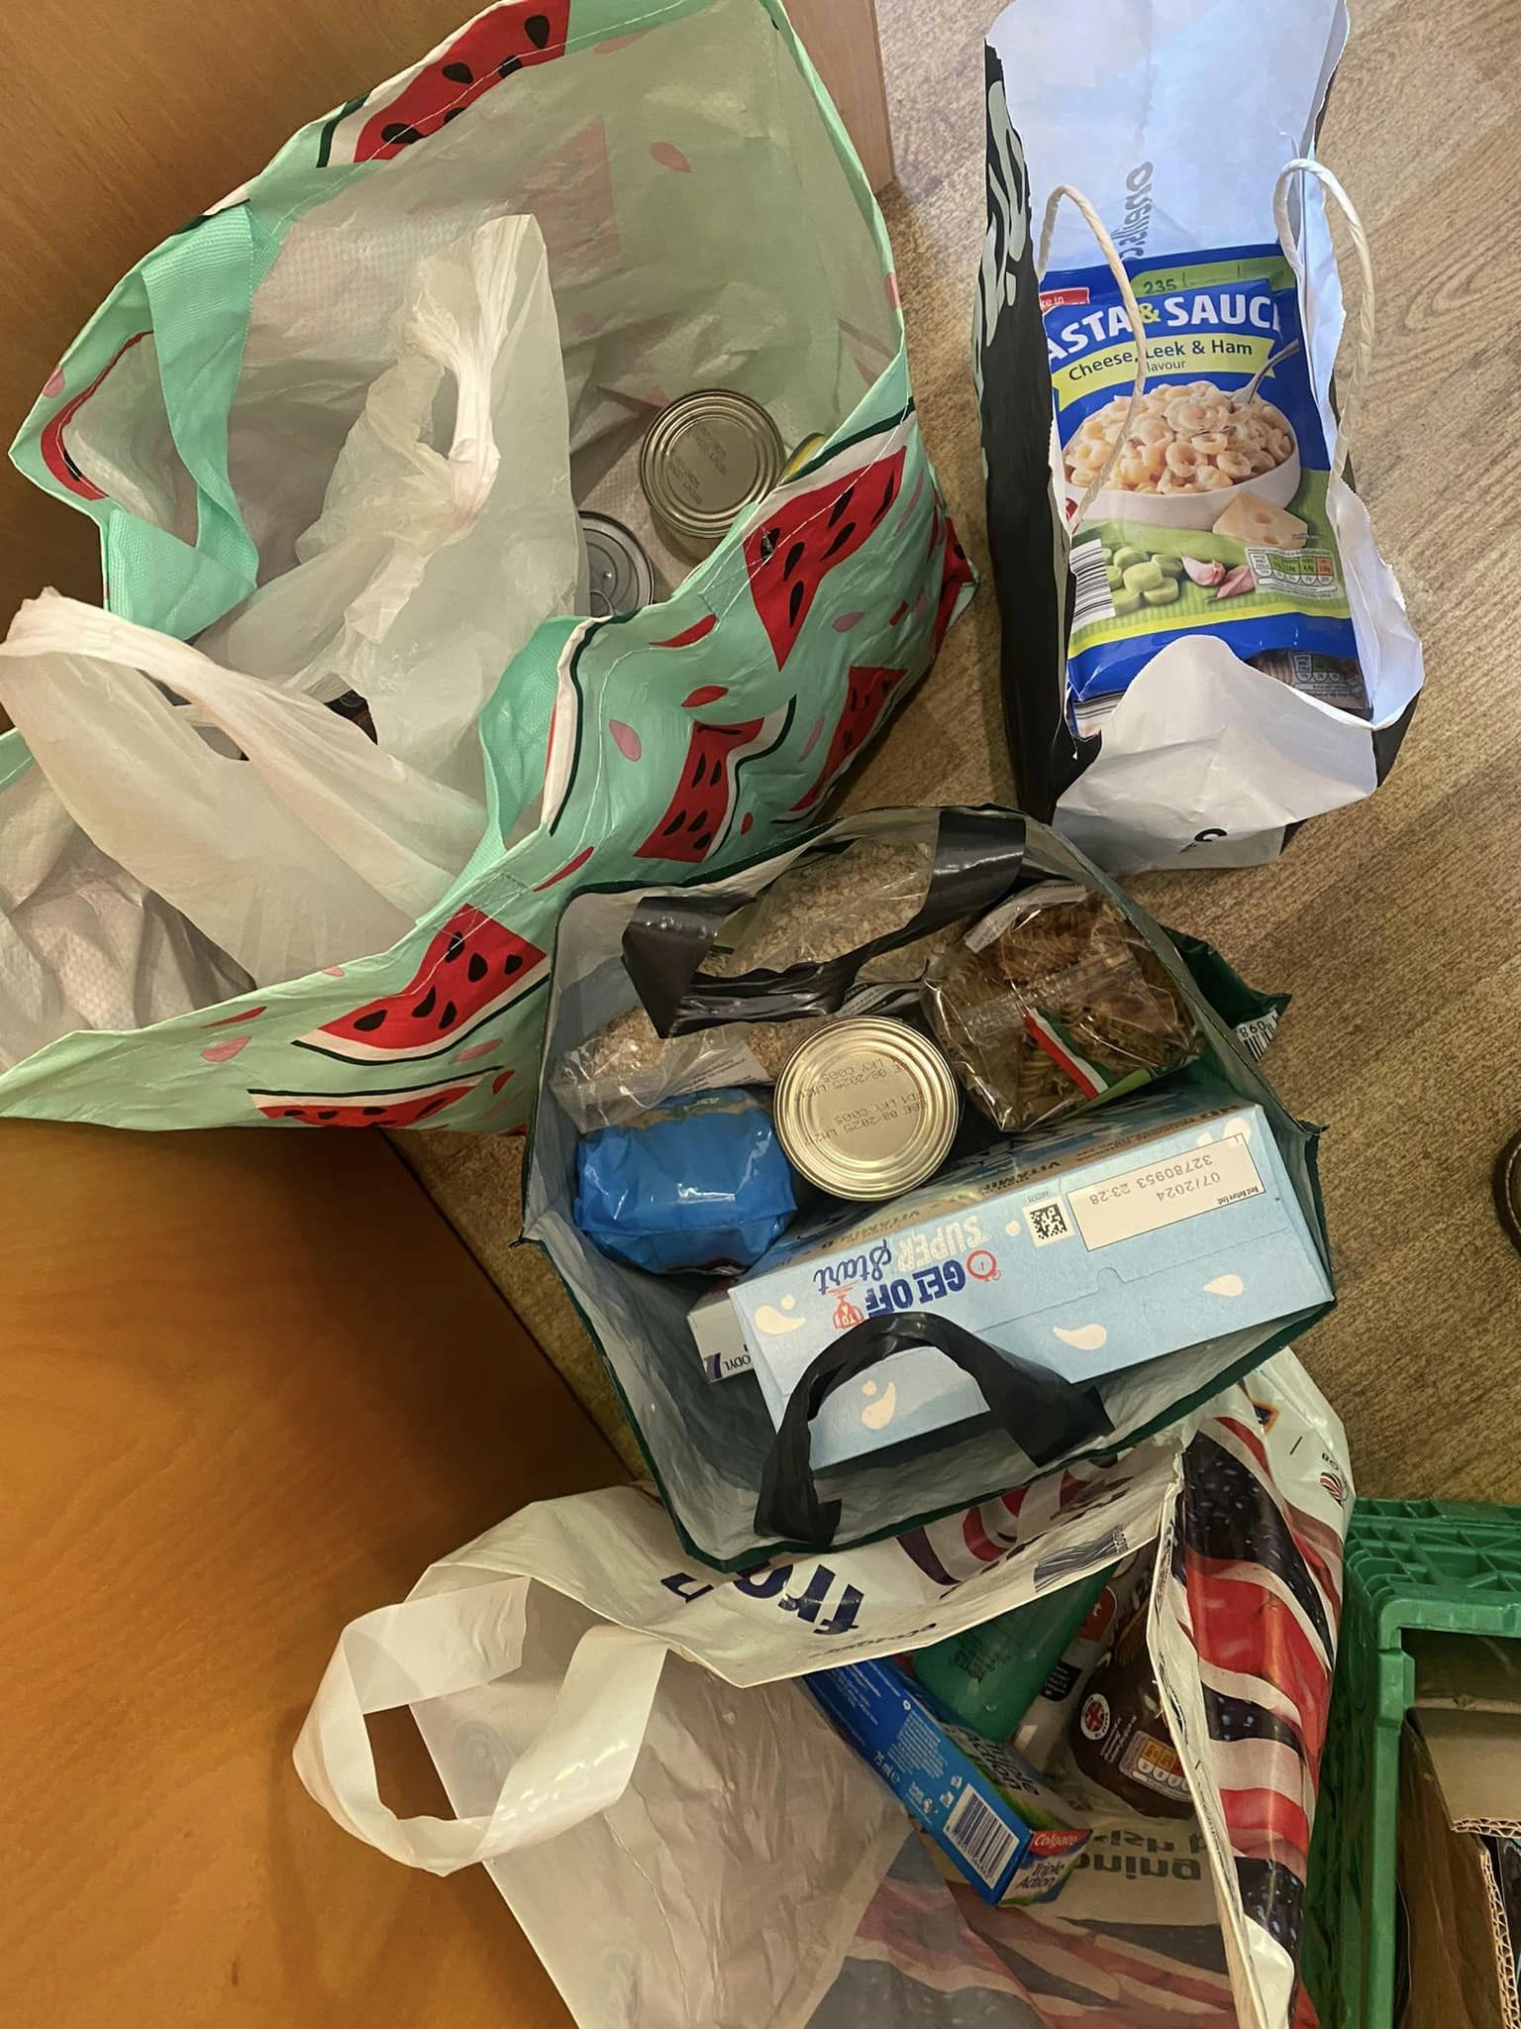
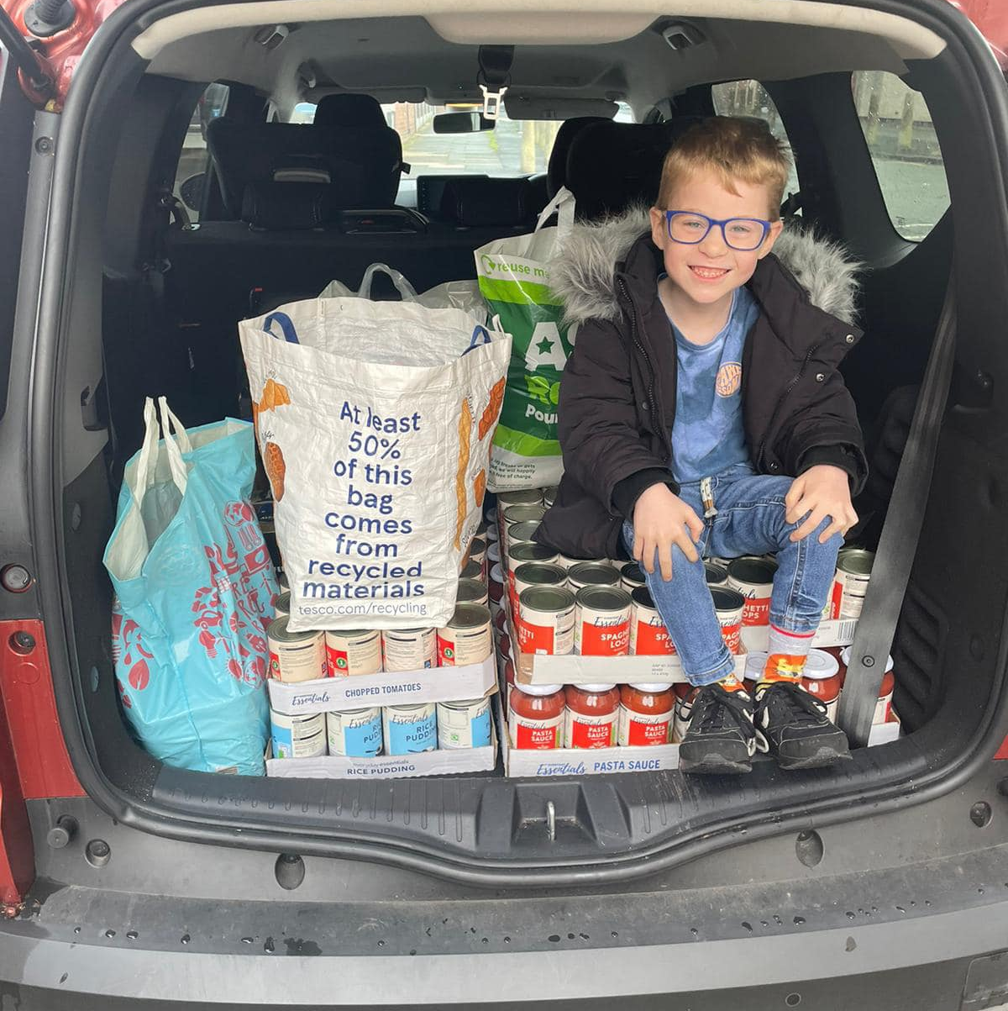
VSNW State of the Sector Report 2023
#Halton
                Halton State of the Sector figures 2023:
724 Charitable organisation's
1861 paid staff
17671 volunteering once at least once month
7276 regular volunteers
23574 hours of volunteering each week
£13.3 million per year value of volunteering

Slide 3
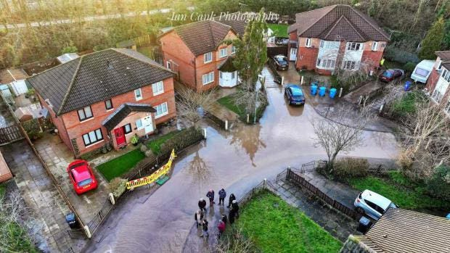
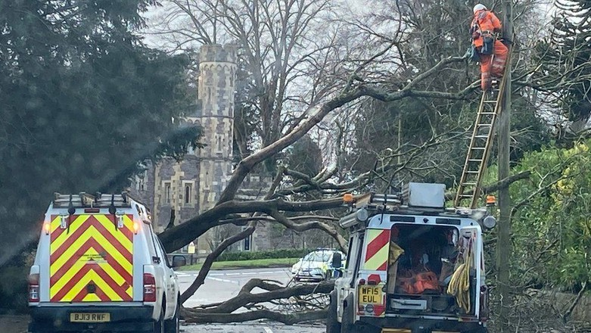
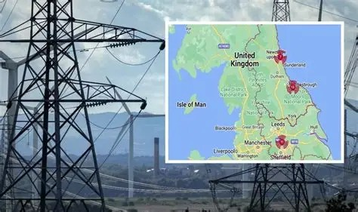
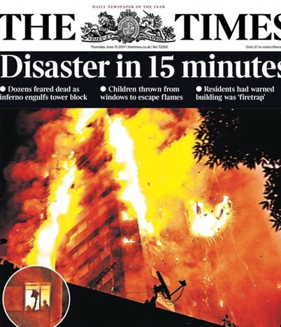
Emergencies Happen...
Emergencies can strike anytime — from severe weather to accidents or infrastructure failures.
Some last hours; others continue for weeks or months. A few simple steps can make a big difference.

Slide 4

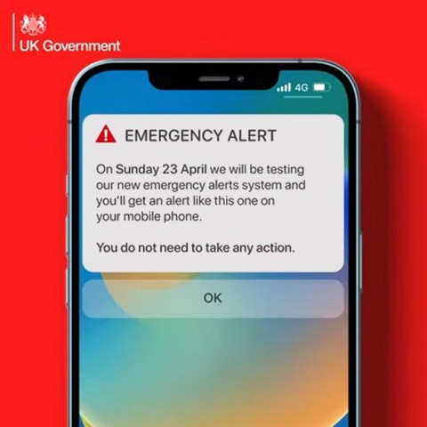

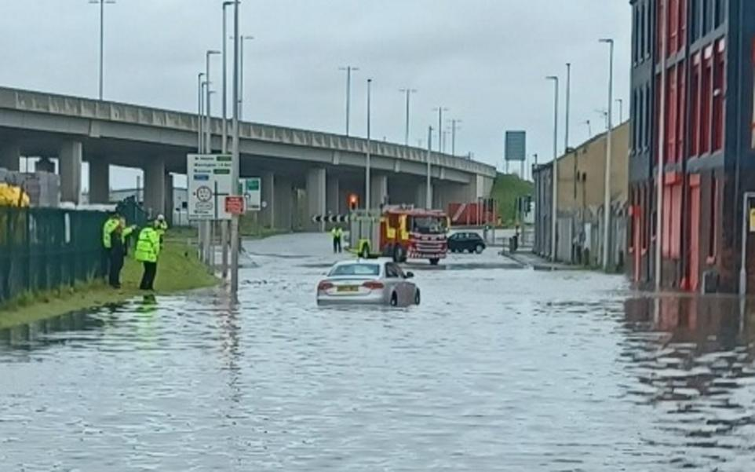
Learn about local risks (e.g., flood zones, severe weather). Check for flooding in Halton - GOV.UK
Sign up for alerts and warnings with trusted, reliable sources: MET Office; Flood Watch Service; PREPARE - alerts and warnings.
Be Informed
Education - stay informed and up to date with the PREPARE website: https://prepare.campaign.gov.uk/
Learn basic first aid — free workshops available online and Adult Learning.
Register for the Priority Services Register (PSR) if you need extra support with gas, water, or energy supplies, and your household as a vulnerable resident. PSR website: thepsr.co.uk
Understand local risks at the Cheshire Resilience Forum and HBC emergency Planning team: https://cheshireresilience.org.uk/

Slide 5

In an emergency, what’s your plan?

Slide 6


Make a Household Emergency Plan
Plan escape routes and meeting points. Write down important numbers (family, doctor, insurance, emergency lines).
Talk to your children — teach them emergency numbers and addresses - trusted adults.
Keep your household emergency plan with passports, insurance, and key documents.
Add “ICE” (in case of emergency) contacts to your mobile for emergency personnel

Slide 7







Prepare Your Home
Test smoke alarms monthly.
Know how to turn off gas, electricity, and water (check PREPARE website)
Check your insurance (especially if you are in a flood area).
Do a home fire safety check online Download and read Cheshire Fire and Rescue - Home Fire Safety Check guide Learn how to prepare your property for floods, storms, heat, and cold.
Some chemical/industrial sites - Go in stay in - tune in

Slide 8
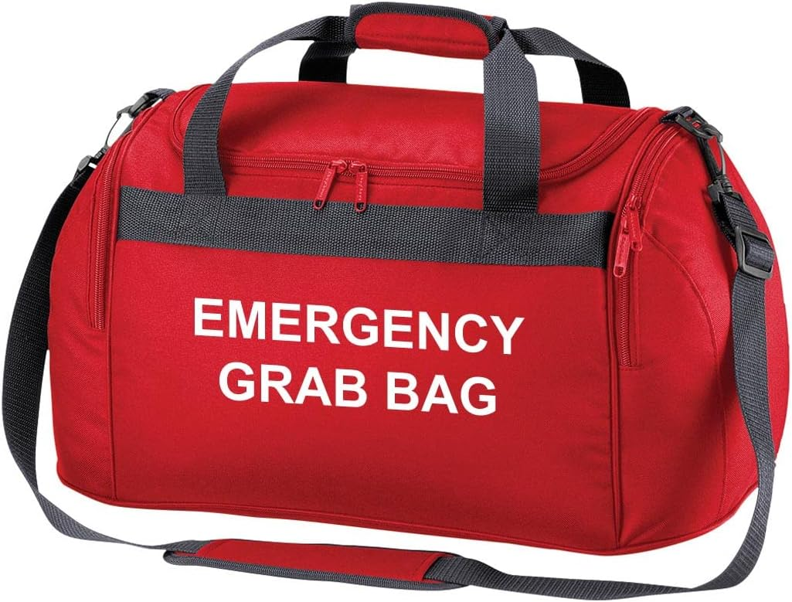
Do you have a Grab Bag?

Slide 9

What would you include in your emergency kit?

Slide 10
What to Include in Your Emergency Kit (also known as ‘grab
bags)
✅ Torch (battery or wind-up)
✅ Portable phone charger
✅ Radio (battery or wind-up)
✅ Spare batteries
✅ First aid kit [with medication]
✅ Hand sanitiser and wet wipes
✅ Bottled water (2.5–3L per person per day minimum)
✅ Non-perishable food + tin opener
✅ Baby supplies & pet food if needed

Slide 11
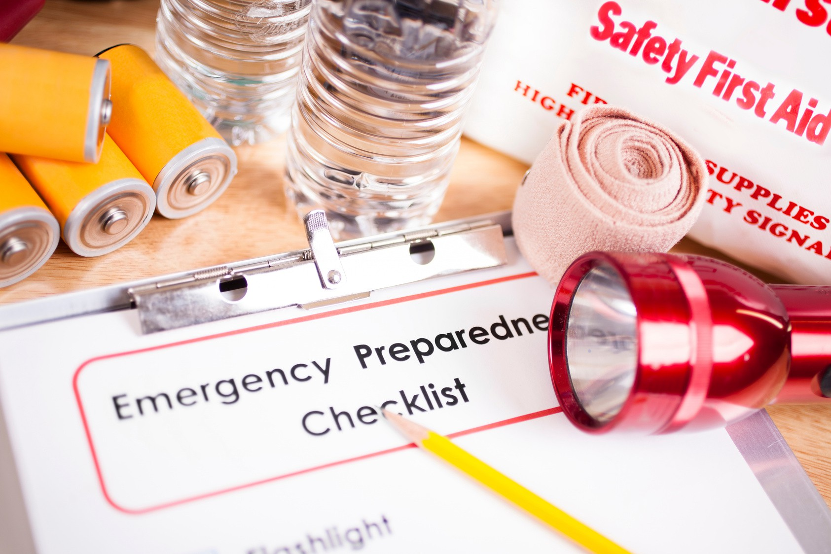
Call to Action
Visit gov.uk/prepare for resources. Sign up for alerts.
Start your emergency plan today!

Slide 12


Key website and sources
PREPARE - https://prepare.campaign.gov.uk/
MET Office (weather warning and updates) - www.metoffice.gov.uk
Cheshire Resilience Forum - www.cheshireresilience.org.uk
Priority Services Register - www.thepsr.co.uk
Cheshire Fire and Rescue - www.cheshirefire.gov.uk
Flood Alerts and Warning (Gov) - https://check-for-flooding.service.gov.uk/alerts-and-warnings/cheshire

Slide 13

Winter Warmer Events and Winter Coat Project

