Slide 1

Agenda
One Neighbourhood Programme
Community Engagement & Empowerment
North Priorities
Priority Marketplace

Slide 2
One Neighbourhood Programme
Transforming local delivery: progress, system change & next phase
Notes:
I want to briefly set out what One Neighbourhood model is and how it works. The programme is about joining up services, partners, communities and insight around people and place. I’ll cover the model, the workstreams, and how blueprints turn ambition into delivery.

Slide 3


Our One Neighbourhood Model
Integrated Neighbourhood Team
4 neighbourhood hubs with a JSNA-led needs-based dynamic INT offer in areas of demand (services could work in an agile way from any hub or have a core base hub)
Health and social care offer
Families First
Minimum of 3 outreach hubs with community virtual/physical hub and needs based service touch points from community and council assets e.g. libraries
Community-led & VCS offer
Adult learning
Service base x4
RESIDENTS
PLACE AND ENVIRONMENT
Digital
Notes:
The ambition is simple: the right help, in the right place, at the right time – ensuring people can thrive where they live. One Neighbourhood brings together community and VCS support, health and care, integrated teams, hubs, digital access, Families First and adult learning—organised around residents and place, not organisational boundaries.
It’s not a single service or a building — it’s a whole-system, place-based delivery model.
all wrapped around residents and place.
The key point is that it’s a connected ecosystem, designed to align around need rather than organisational boundaries.

Slide 4
Working differently around people and place
What changes in practice
Seven workstreams.
One neighbourhood model.
• Bring together council services, partners, communities and local assets.
• Use data, service intelligence and resident voice together.
• Understand what matters in each neighbourhood.
• Build around prevention, earlier help and joined-up delivery.
• Create a clearer route from insight to action.
• Population Data & Insight
• Place & Environment
• Workforce Development
• Digital Enablement
• Families First
• Neighbourhood Health
• Community Engagement & Empowerment
Notes:
This is not about doing more disconnected activity in neighbourhoods. It is about working differently: combining data, resident voice, service knowledge and local assets to understand what matters, intervene earlier and turn shared insight into coordinated action.
Seven workstreams build the model: data and insight, community engagement, place and environment, workforce, digital enablement, Families First and neighbourhood health. They are not separate projects. Their value comes from connecting around one place, one set of priorities and one shared delivery model.

Slide 5
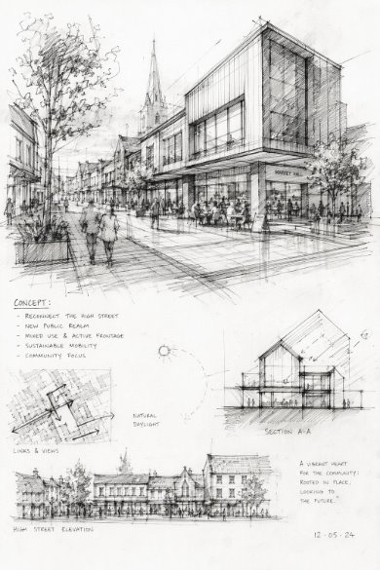
Blueprint development
Analyse need + assets
Prioritise with evidence + voice
Build one shared plan
Agree ownership + measures
Learn before scaling
Notes:
The blueprint is where the model becomes practical. We analyse need and assets, test priorities against evidence and resident voice, agree one shared plan, and make ownership and measures clear. Then we learn from delivery before scaling the approach and moving on to the next neighbourhood in the sequence.

Slide 6

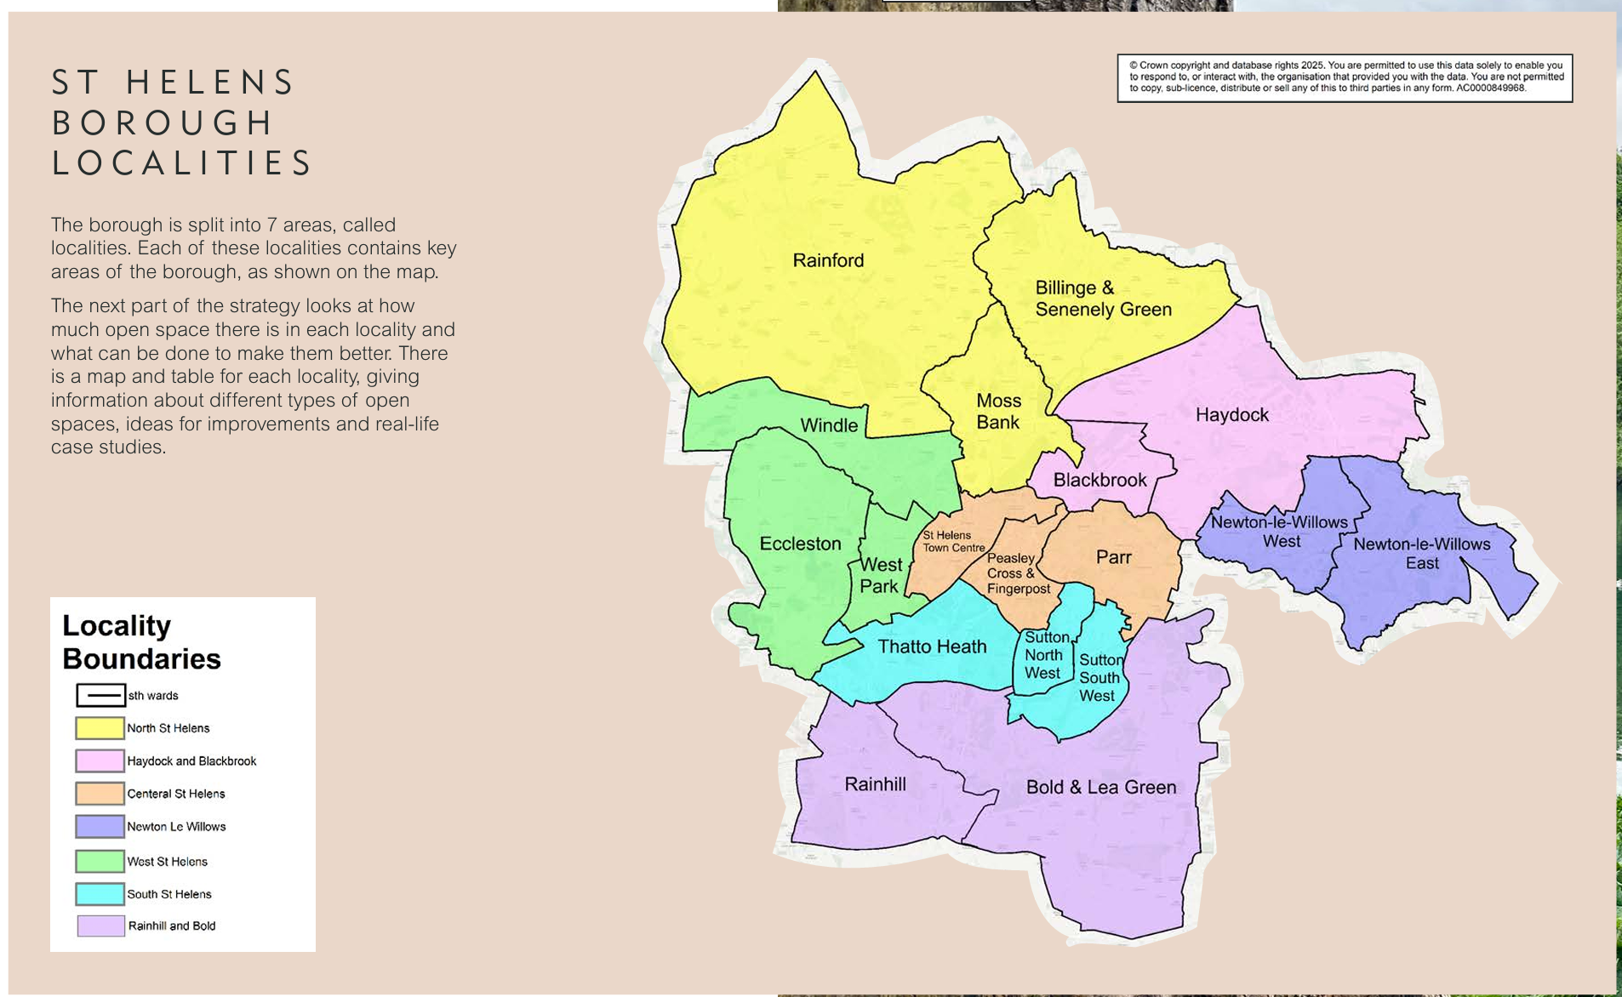
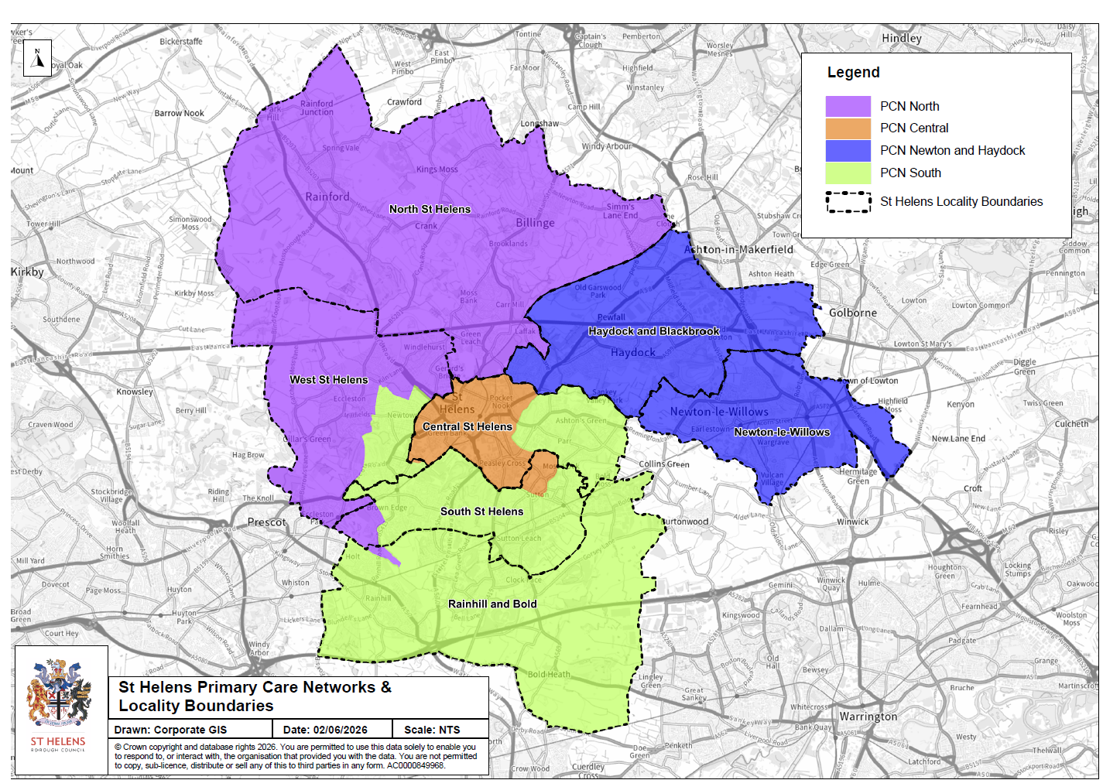
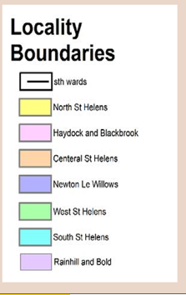
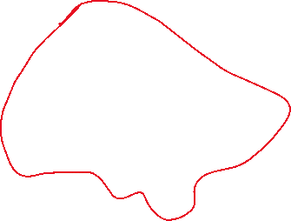
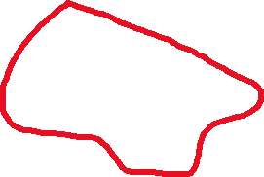
The programme will initially focus on the North of St Helens. This is defined by the locality boundary and includes Rainford, Billinge & Seneley Green and Moss Bank
Notes:
We are starting with North deliberately. It is our first proof of concept: a chance to test the method, learn quickly and strengthen the approach before moving to other neighbourhoods. That concludes my introduction. I'll pass over to Michelle to talk through what this looks like in practice through the North engagement. We are here to get your input so please feel free to ask questions, make suggestions and talk to me about how oyu can help support this work

Slide 7

Community Engagement & Empowerment
Notes:
Bev

Slide 8
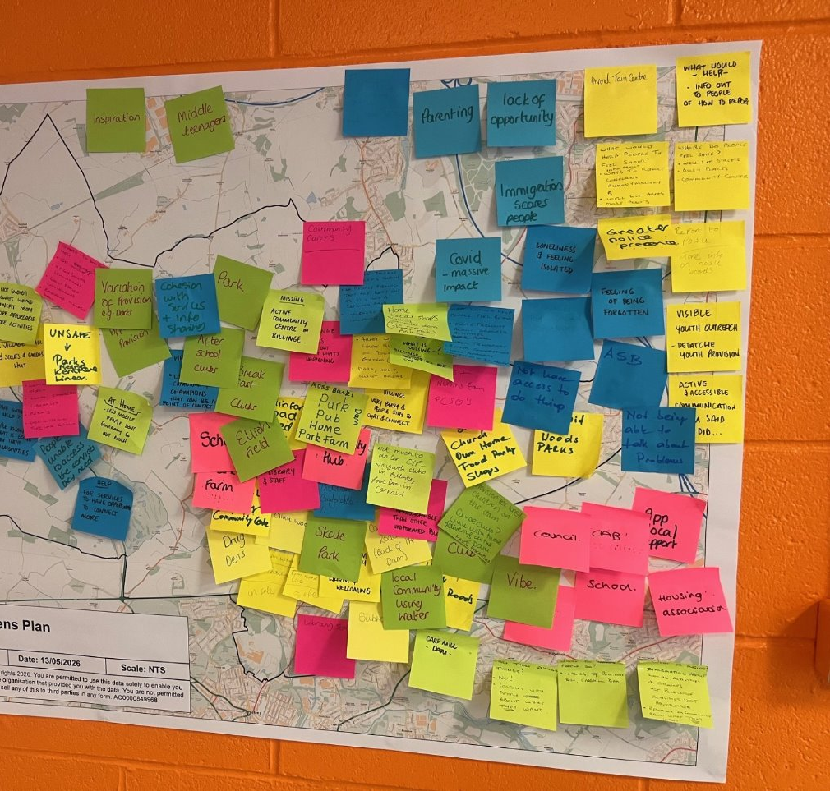
Listening & Learning
in North
St Helens
Notes:
Before we move into the priorities themselves, I wanted to spend a few minutes explaining how we've listened to local people and gathered community insight.
One Neighbourhood is built on the principle that solutions shouldn't just be designed around data or organisational perspectives. They should be informed by the people who live, work and spend their time in North St Helens.
Alongside the quantitative data and service information that Bev has just talked about, we've been gathering local stories, experiences, observations and ideas from residents, community groups, young people and frontline partners.
This approach allows us to understand not just what is happening, but why it is happening and what matters most to local people

Slide 9

Engagement Approach:
North Neighbourhood Voice Network
& targeted engagement sessions
Notes:
To do this, we used a combination of our Neighbourhood Voice Network and targeted engagement activities.
We wanted to hear from a broad cross-section of the community, including schools, voluntary and community organisations, local residents, housing partners, libraries, PCSOs and community leaders.
We spoke with children and young people through Carr Mill Primary School and Rainford High School. We worked with community organisations including Park Farm Community Centre, St Aidan's Food Pantry and local youth groups.
We also worked through existing community relationships to ensure that local people were at the heart of the conversation.
Importantly, this wasn't intended to be a statistically representative consultation. It was about gathering authentic community perspectives and local intelligence to help us interpret the wider evidence base and identify recurring themes

Slide 10
Engagement Approach
Utilising 'Neighbourhood Voice Network' & targeted engagement sessions
Education: Carr Mill Primary, Rainford High School
Voluntary & Community Sector: VCA, Park Farm Community Centre (Carr Mill), Boys Brigade & Girls Association (Rainford), St Aidens Food Pantry (Billinge)
Local Residents: Dave (Rainford) Christine (Rainford) Joan (Billinge) Lynne (Billinge/ Garswood) Nikki (Carr Mill)
Local Services & Partners:
Libraries, Torus Housing, PCSOs
VOCAL Champion: Lynne
Young people aged 14-18 years: Representatives from Rainford High & Boys Brigade/ Girls Association
Notes:
To do this, we used a combination of our Neighbourhood Voice Network and targeted engagement activities.
We wanted to hear from a broad cross-section of the community, including schools, voluntary and community organisations, local residents, housing partners, libraries, PCSOs and community leaders.
We spoke with children and young people through Carr Mill Primary School and Rainford High School. We worked with community organisations including Park Farm Community Centre, St Aidan's Food Pantry and local youth groups.
We also worked through existing community relationships to ensure that local people were at the heart of the conversation.
Importantly, this wasn't intended to be a statistically representative consultation. It was about gathering authentic community perspectives and local intelligence to help us interpret the wider evidence base and identify recurring themes

Slide 11
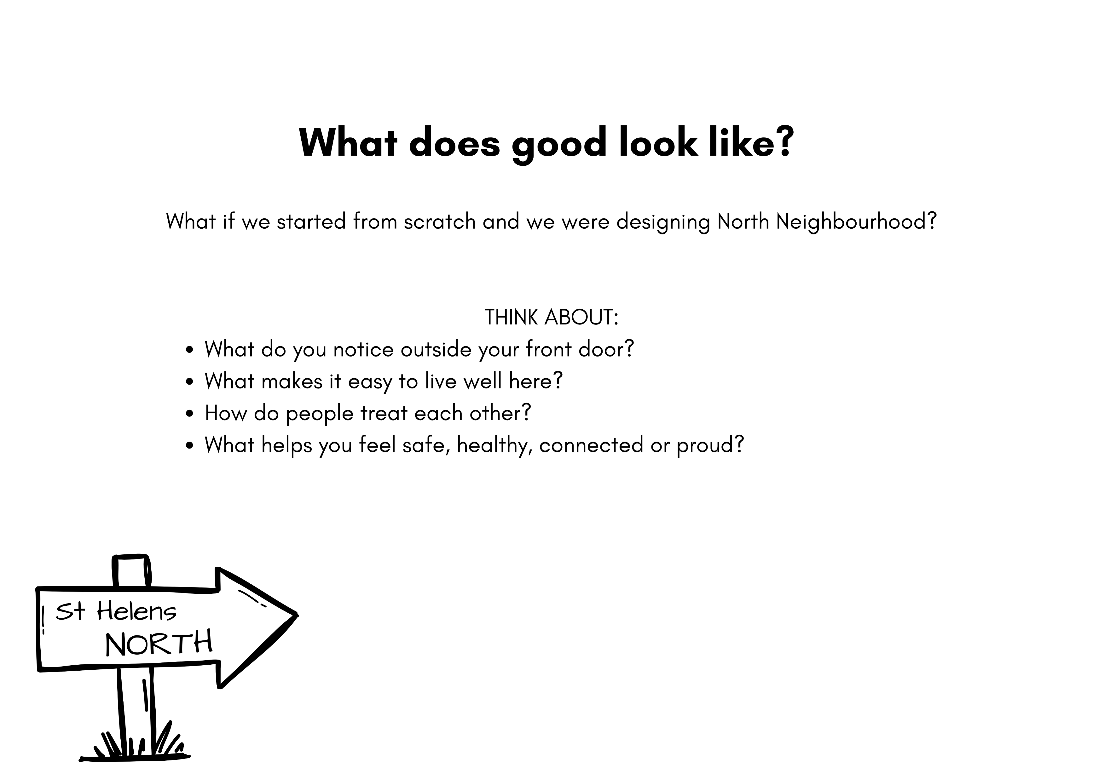
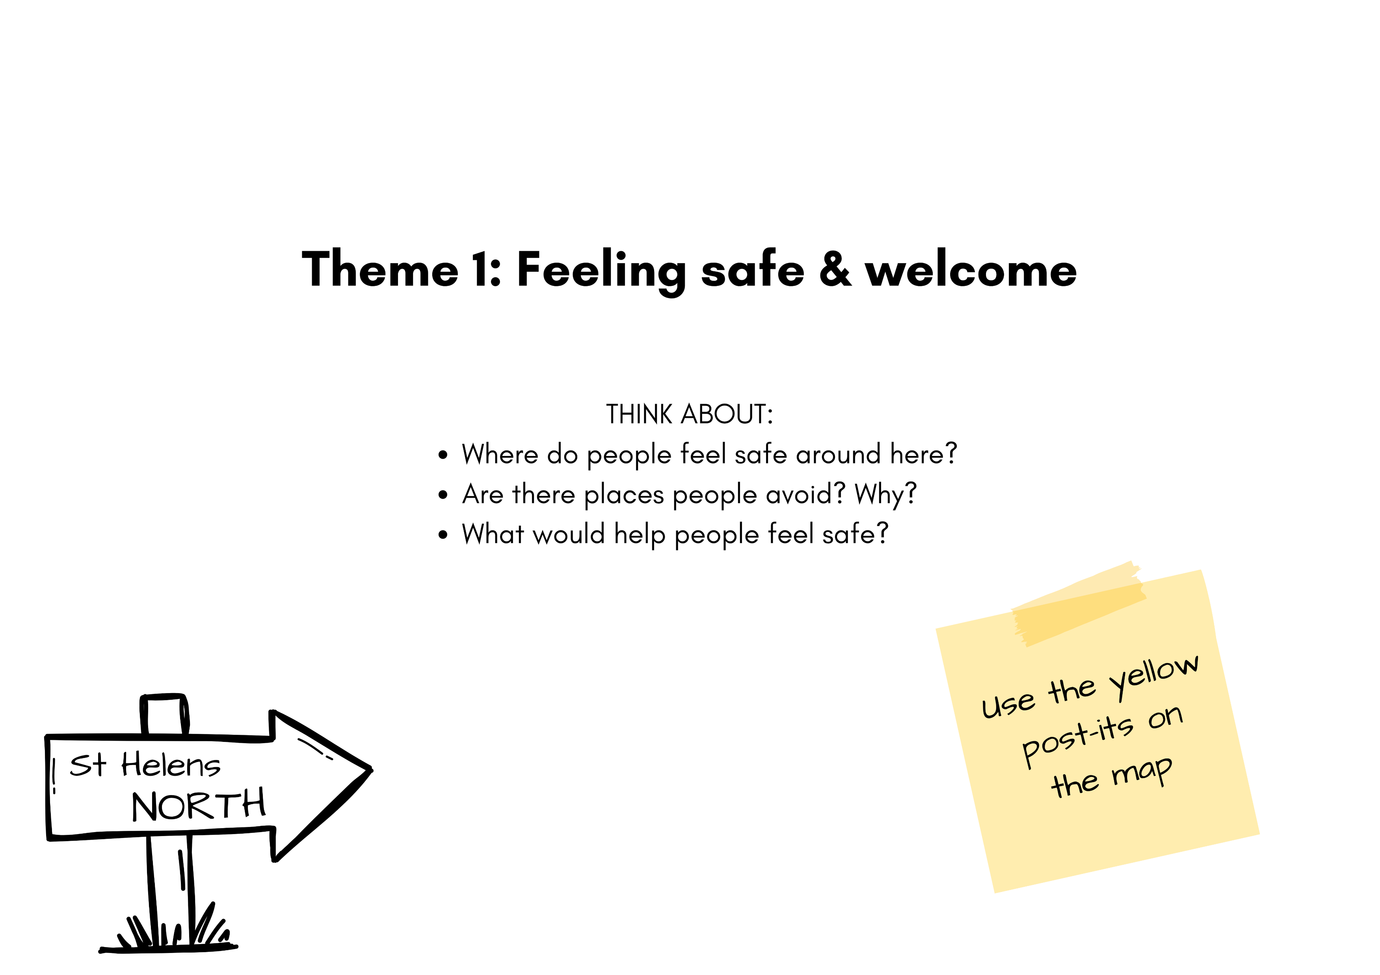
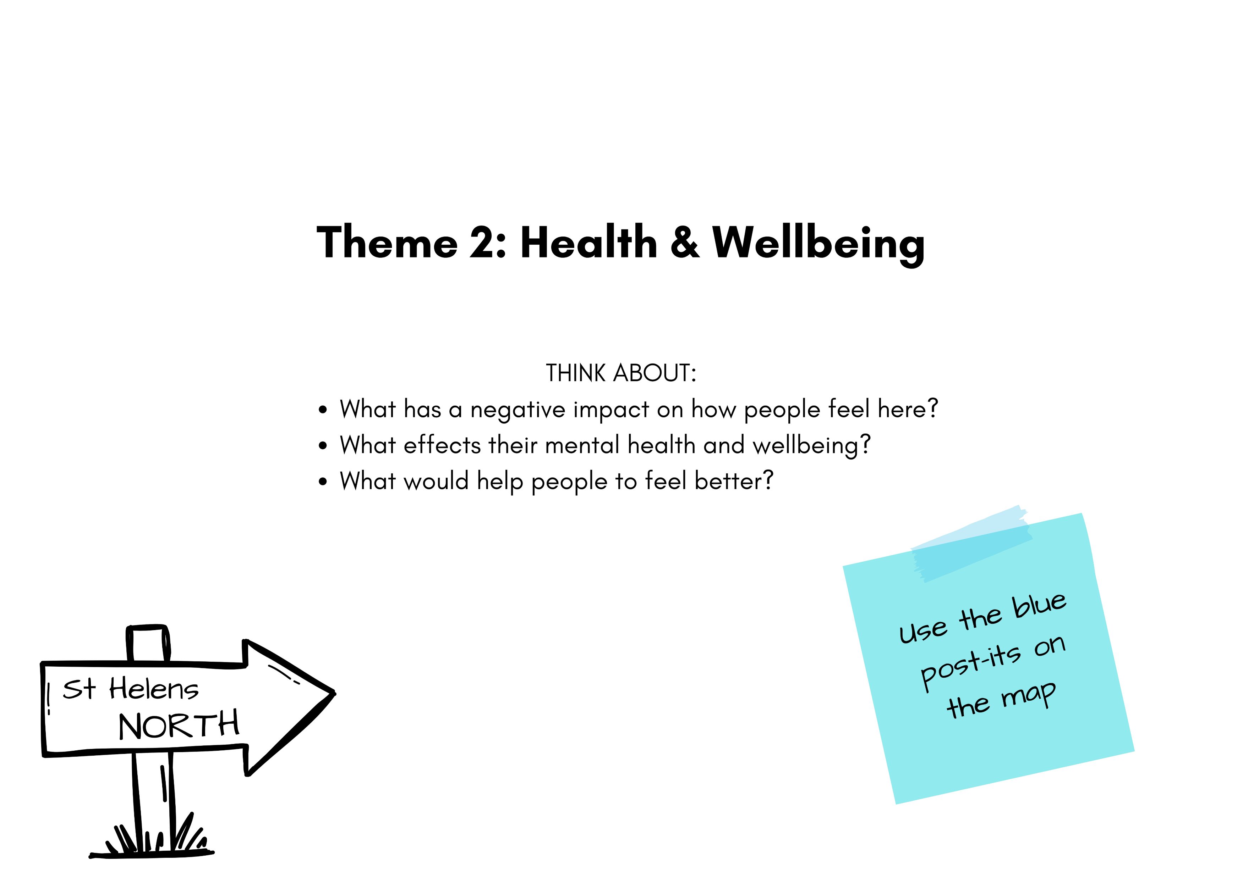
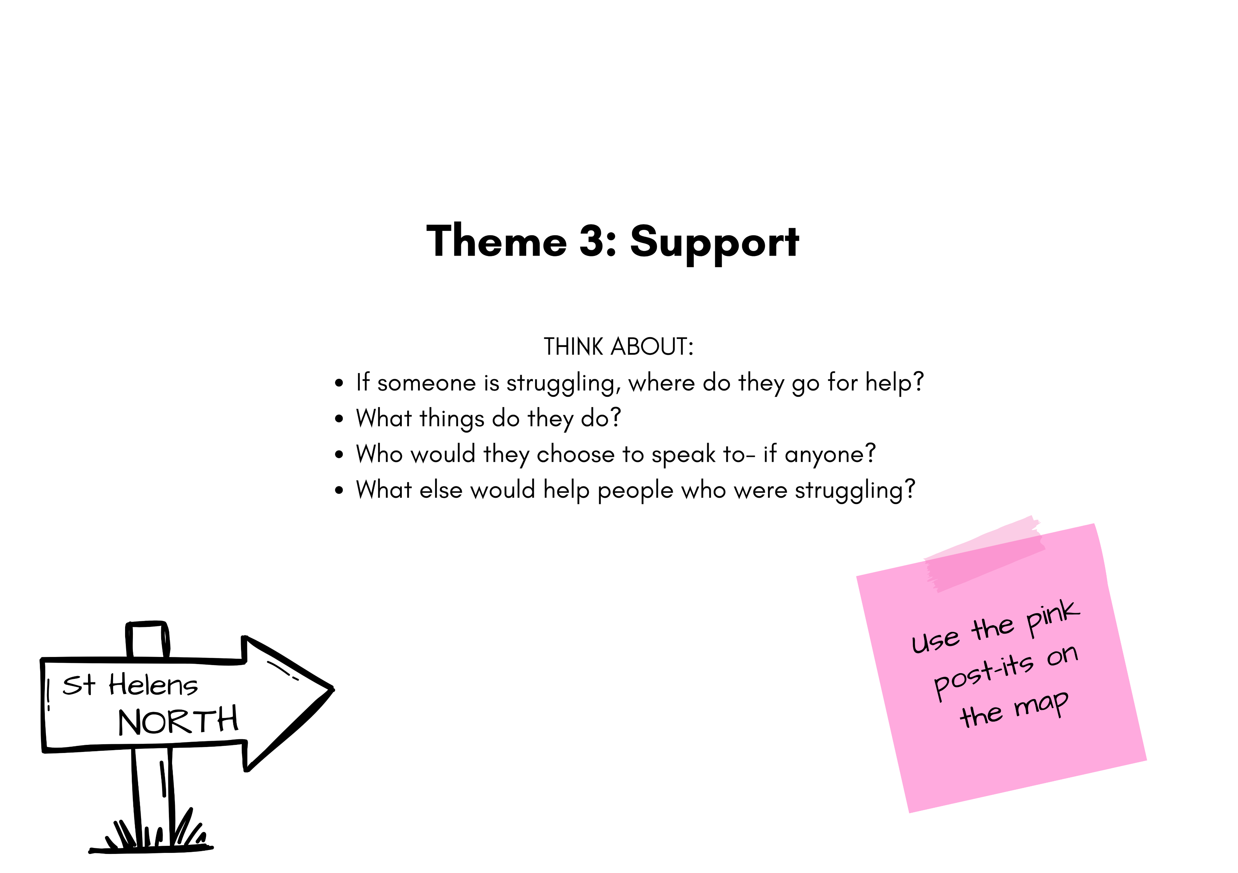
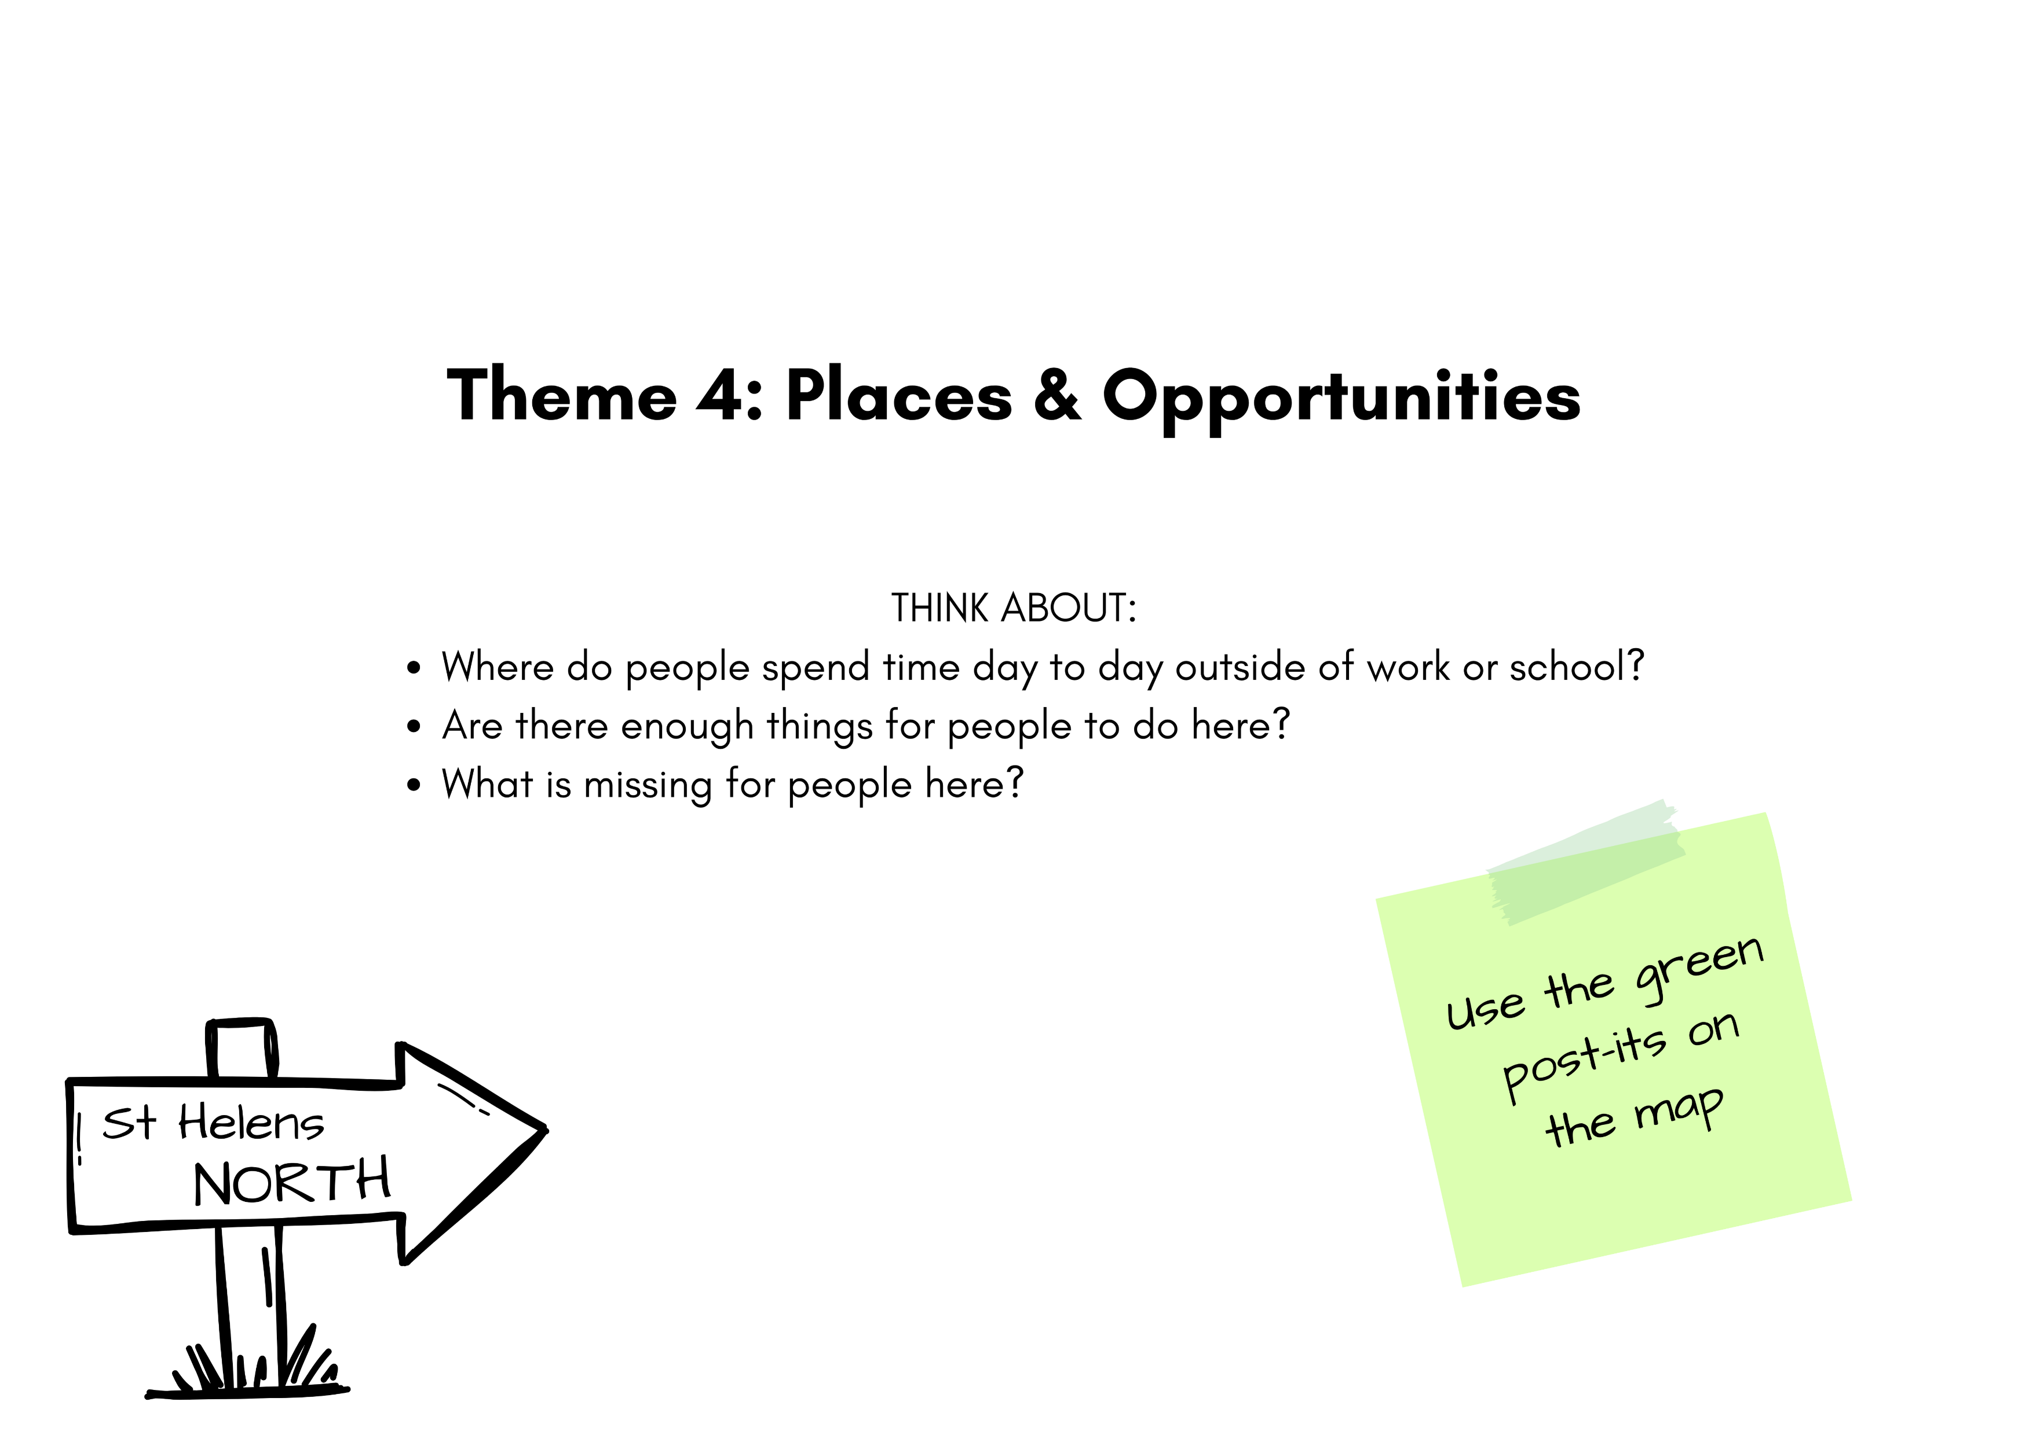
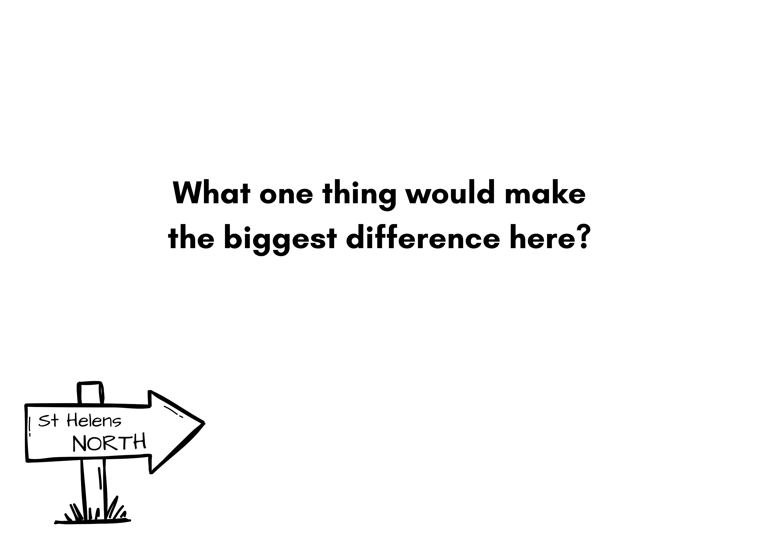
Notes:
The conversations themselves were deliberately simple.
Rather than asking people about council services or organisational structures, we started with a much broader question:
'If we were designing North Neighbourhood from scratch, what would good look like?'
From there we explored four areas which were coming out of the data sets that Bev was drawing upon.
Firstly, feeling safe and welcome – where people feel safe, where they don't, and what would increase their sense of safety.
Secondly, health and wellbeing – what helps or harms people's wellbeing and what would improve quality of life.
Thirdly, support – where people turn when things become difficult, who they trust, and what support is missing.
And finally, places and opportunities – what people value about where they live, how they spend their time and what opportunities they feel are lacking.
We closed every conversation with one final question: 'What one thing would make the biggest difference here?' because that often gets to the heart of what matters most.

Slide 12
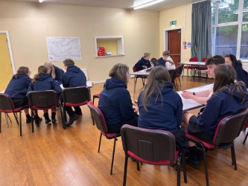
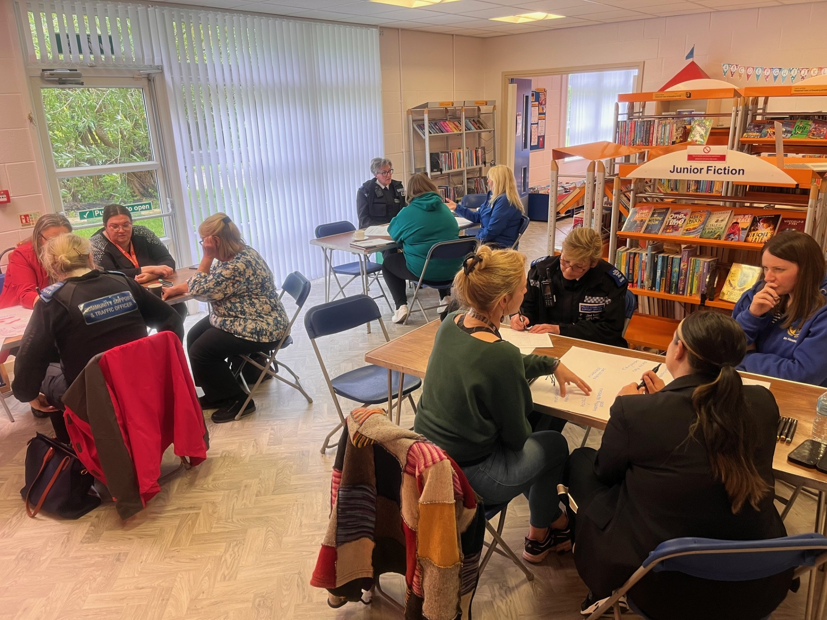
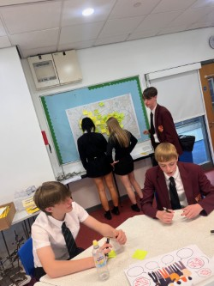
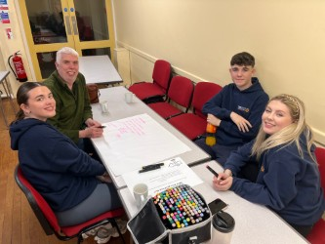
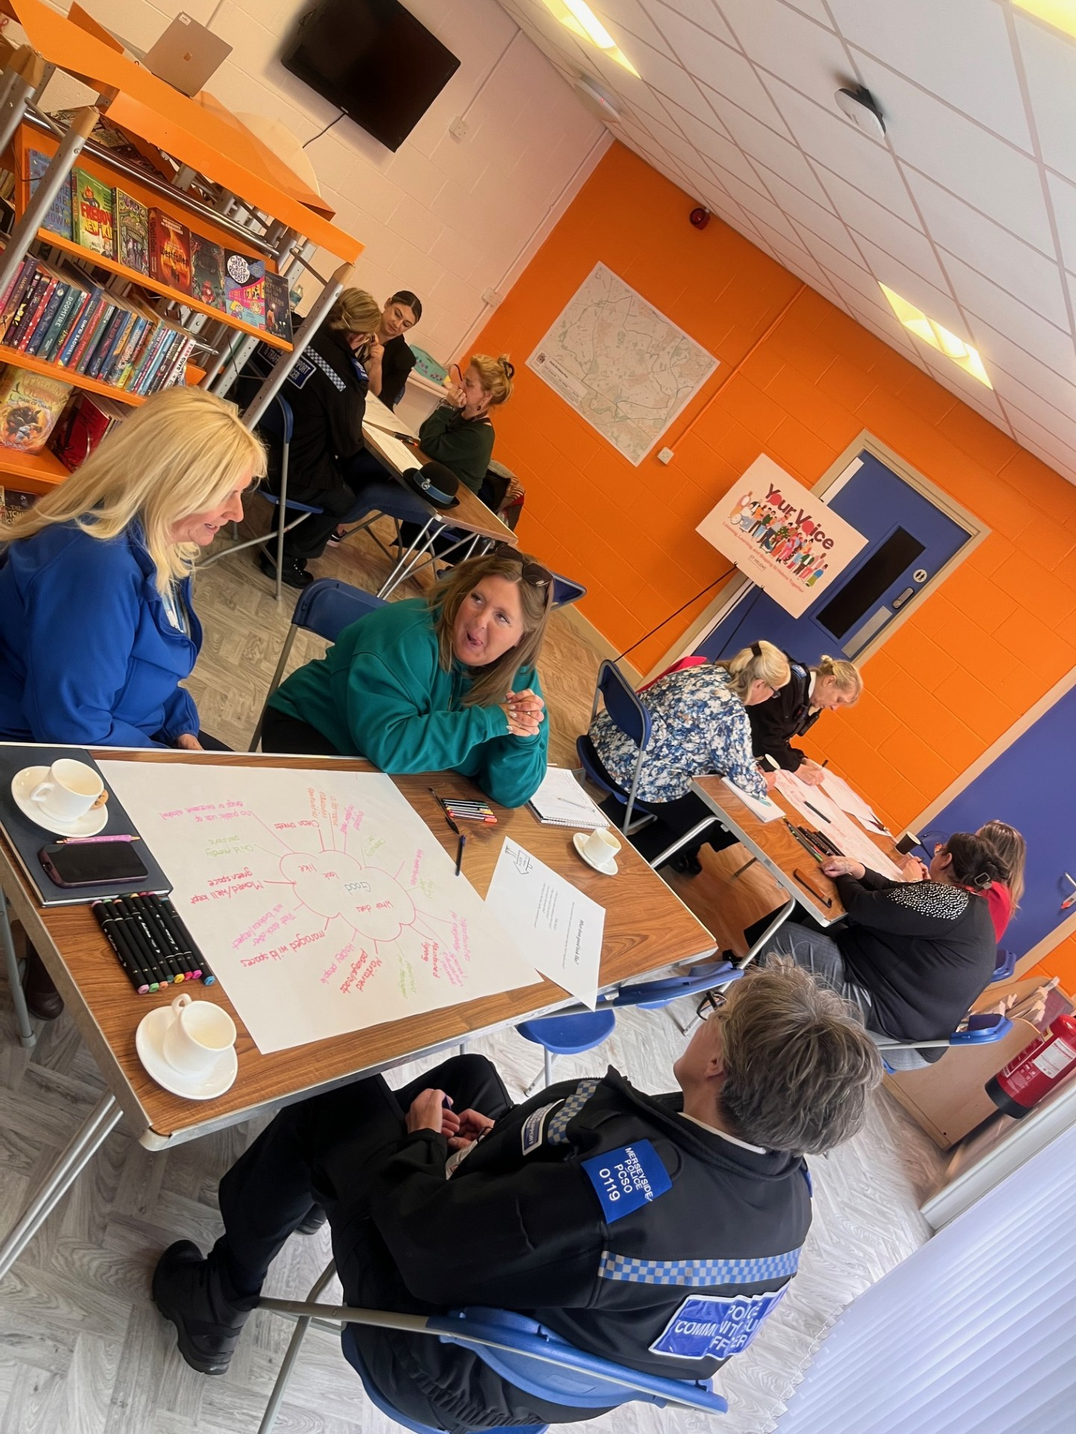
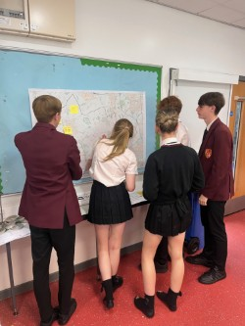
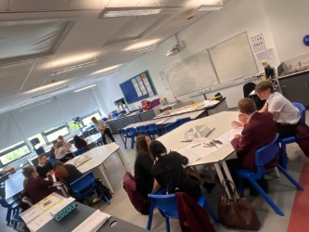
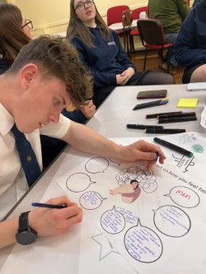
E
Notes:
As you can see, we held conversations in a variety of settings and with different groups across the North locality.
The photographs on the slide reflect some of those discussions and activities.
What was encouraging was the consistency of the themes emerging, regardless of who we spoke to. People clearly care about their communities, value local relationships and want support that feels accessible, connected and responsive.
The priorities we're going to look at next are not solely based on community feedback, nor solely on data. They have emerged through bringing those different sources of intelligence together, helping us build a richer picture of need, opportunity and community strengths in North St Helens.

Slide 13
Emerging Priorities when insights are triangulated with data sets
Notes:
Having looked at the data and listened to community voices, we've started to identify a number of emerging priorities for North.
These are not final priorities. Today's workshop is designed to test them, challenge them and strengthen them through your experience, knowledge and evidence.

Slide 14
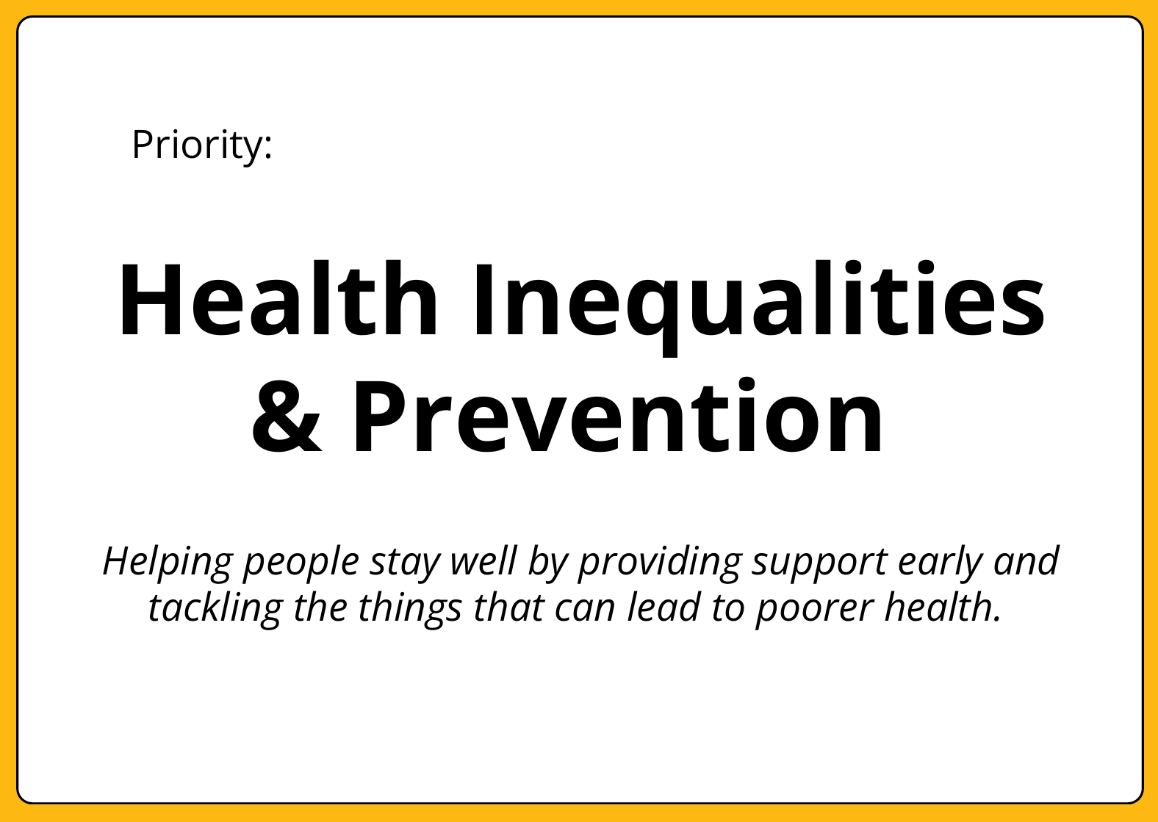
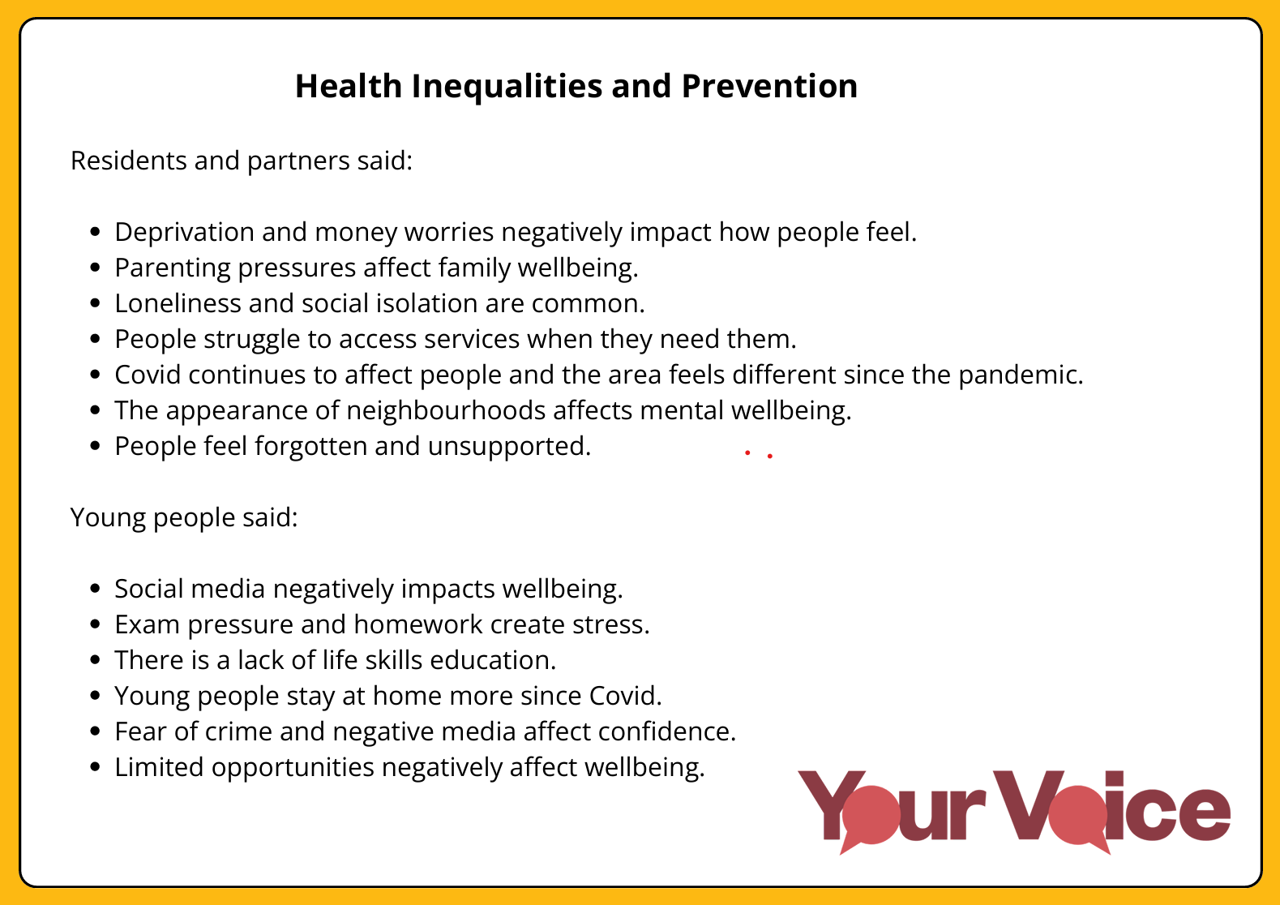
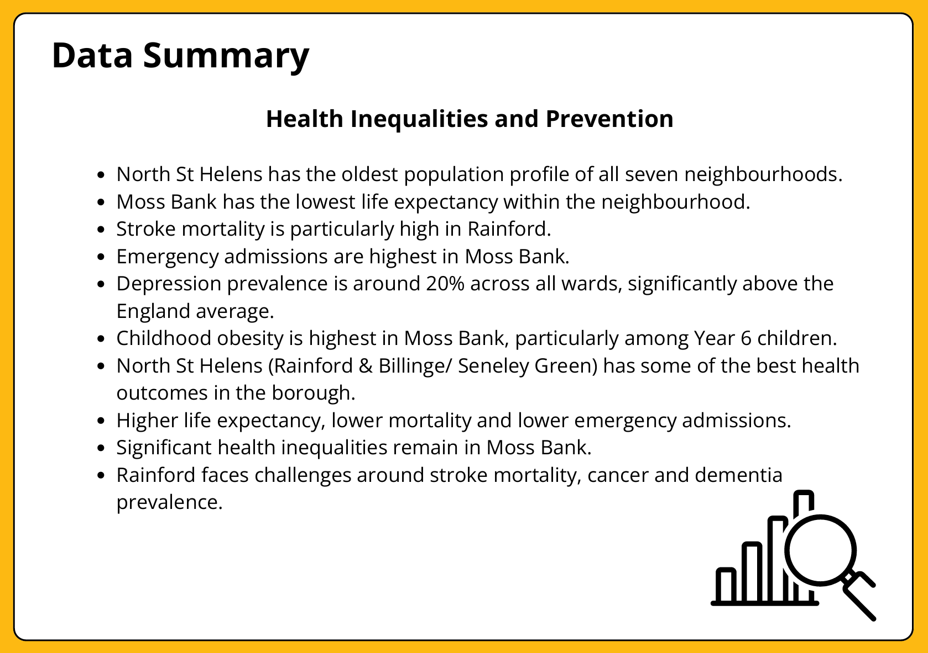
1.

Slide 15
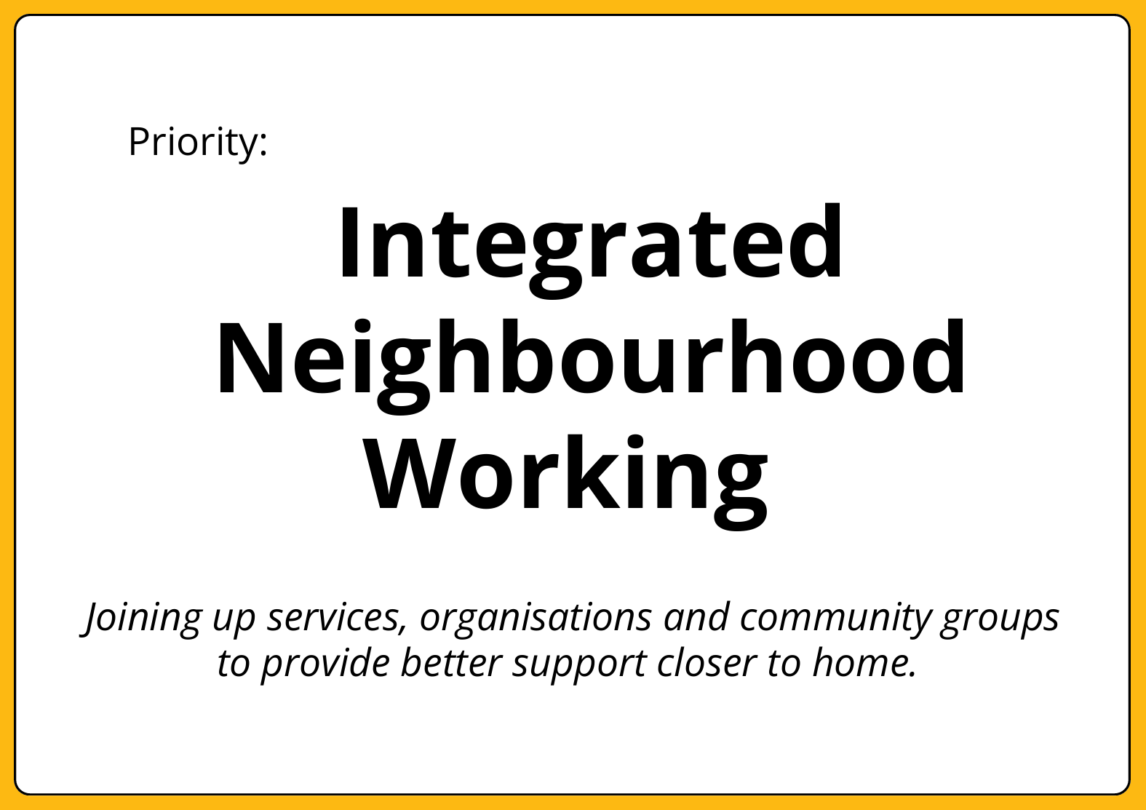
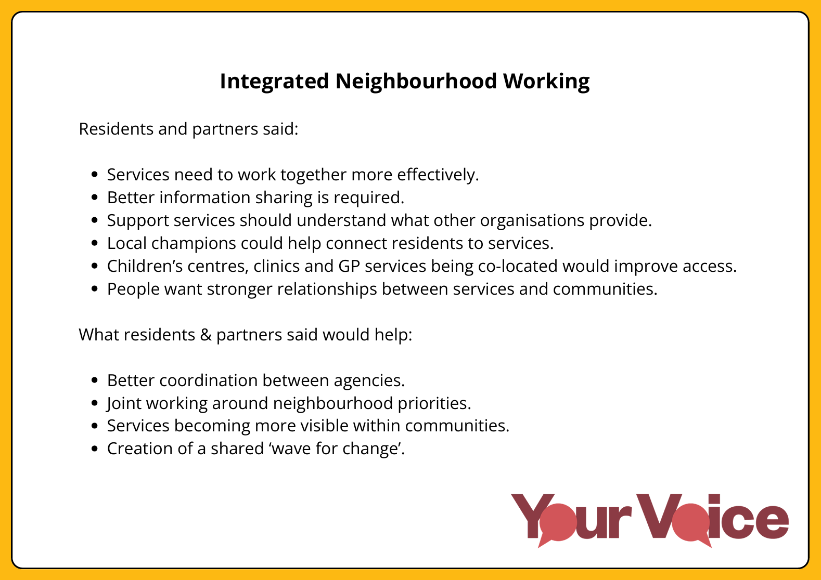
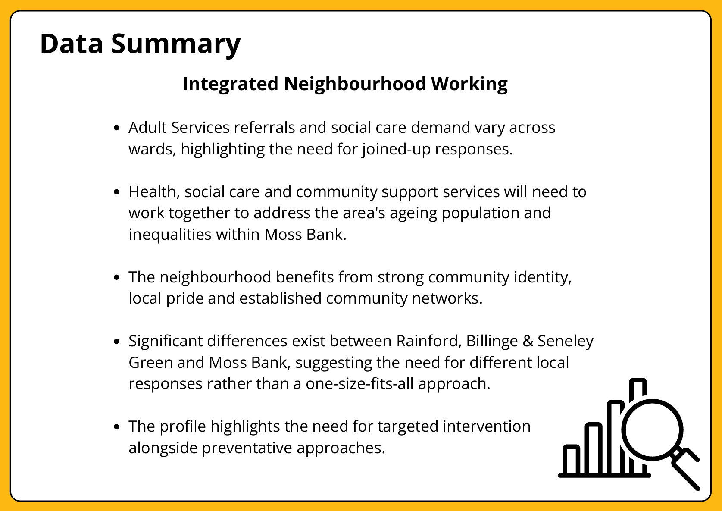
2.

Slide 16
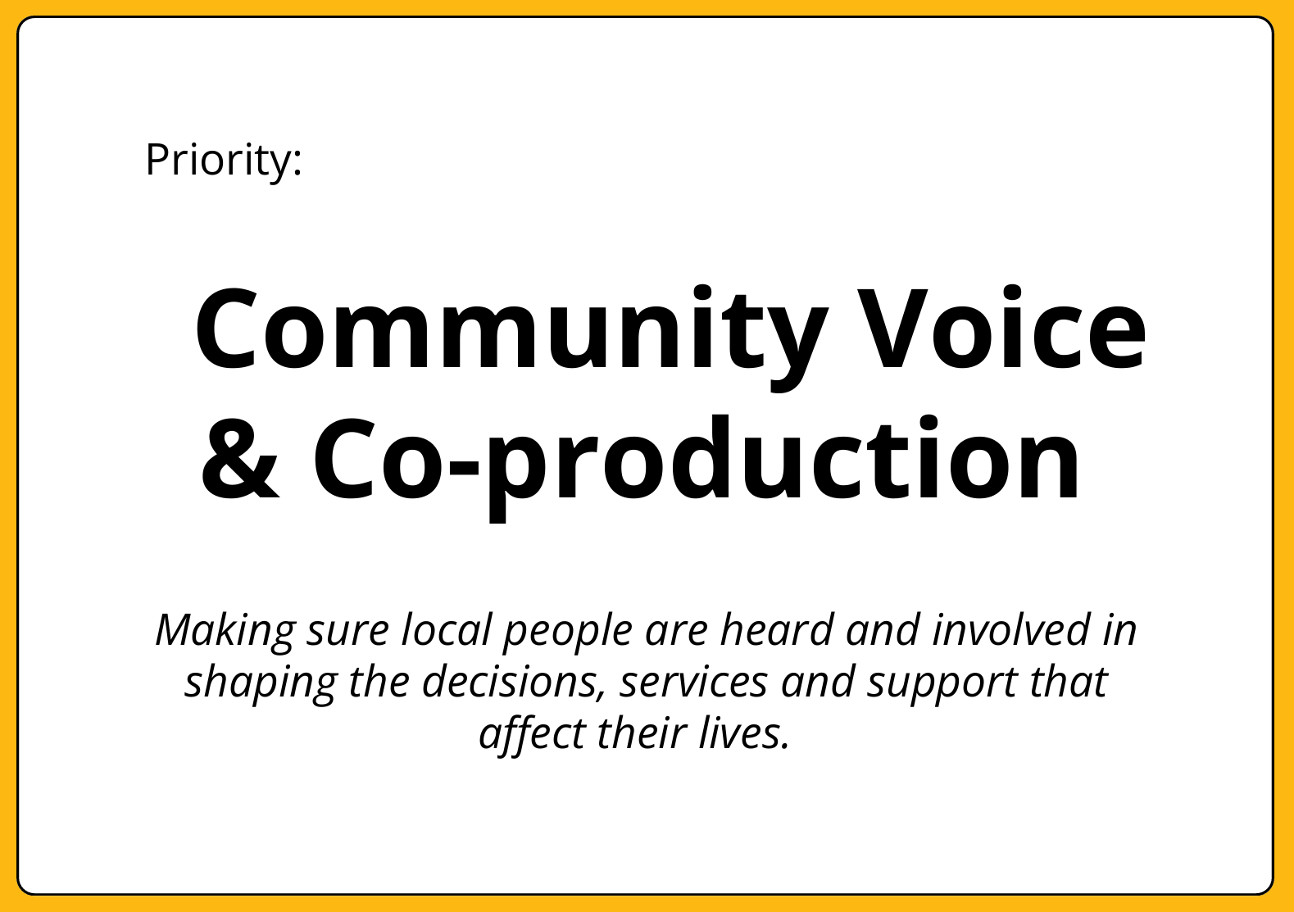
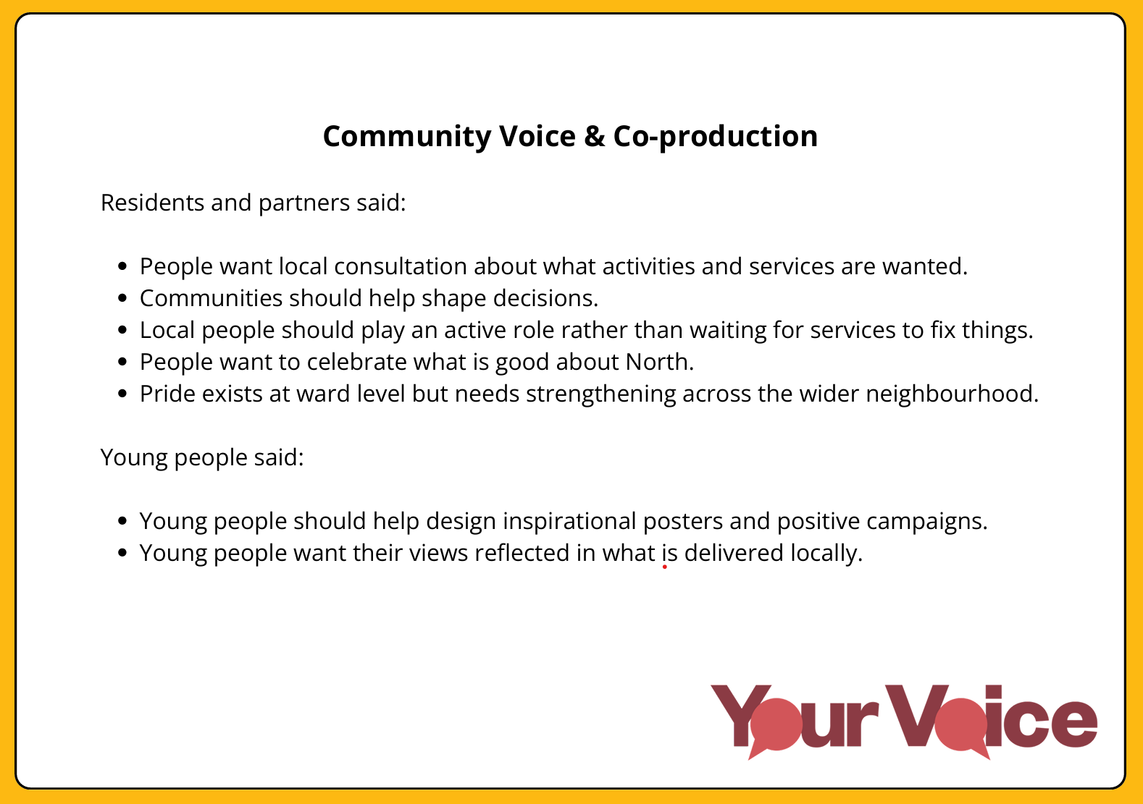
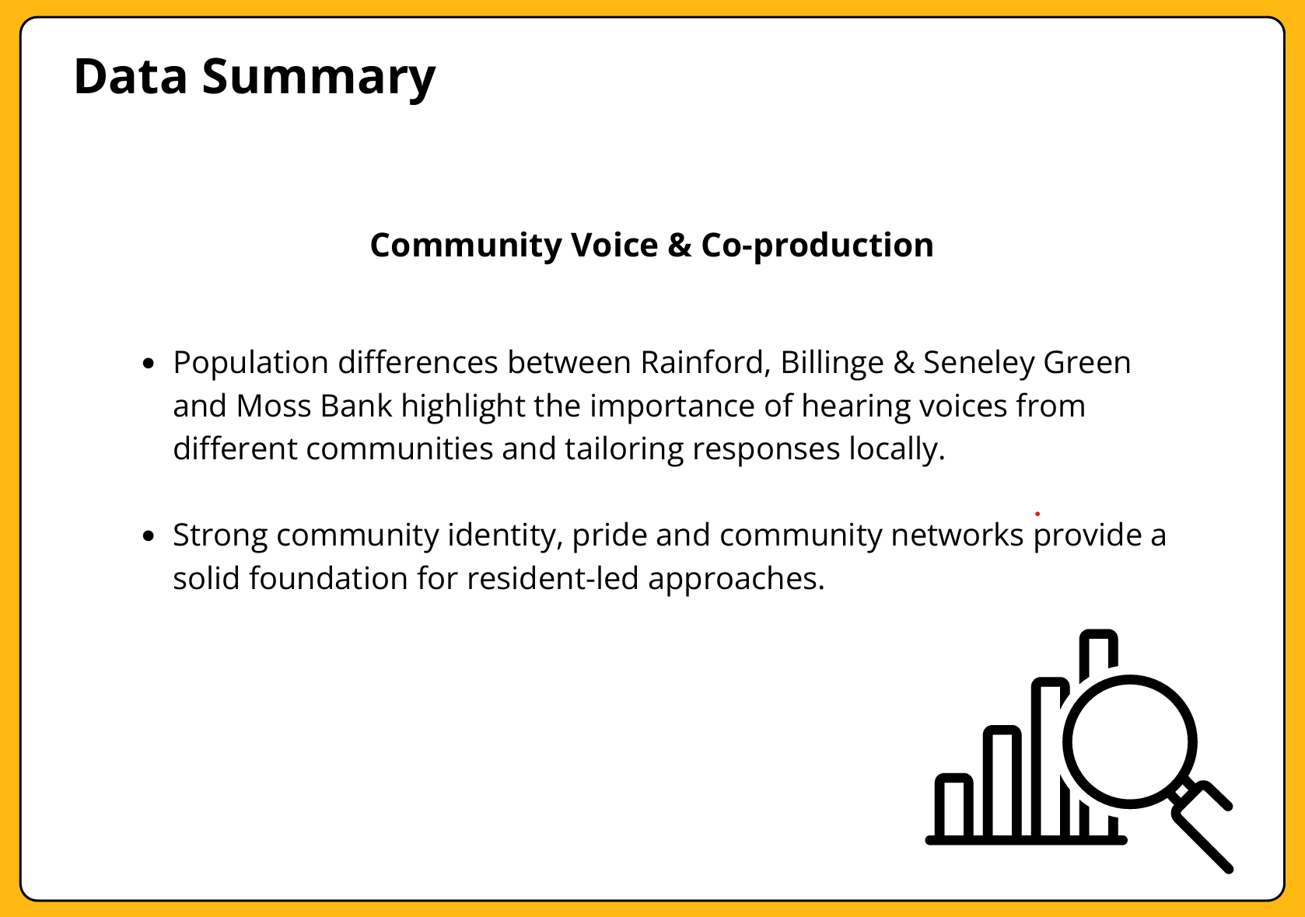
3.

Slide 17
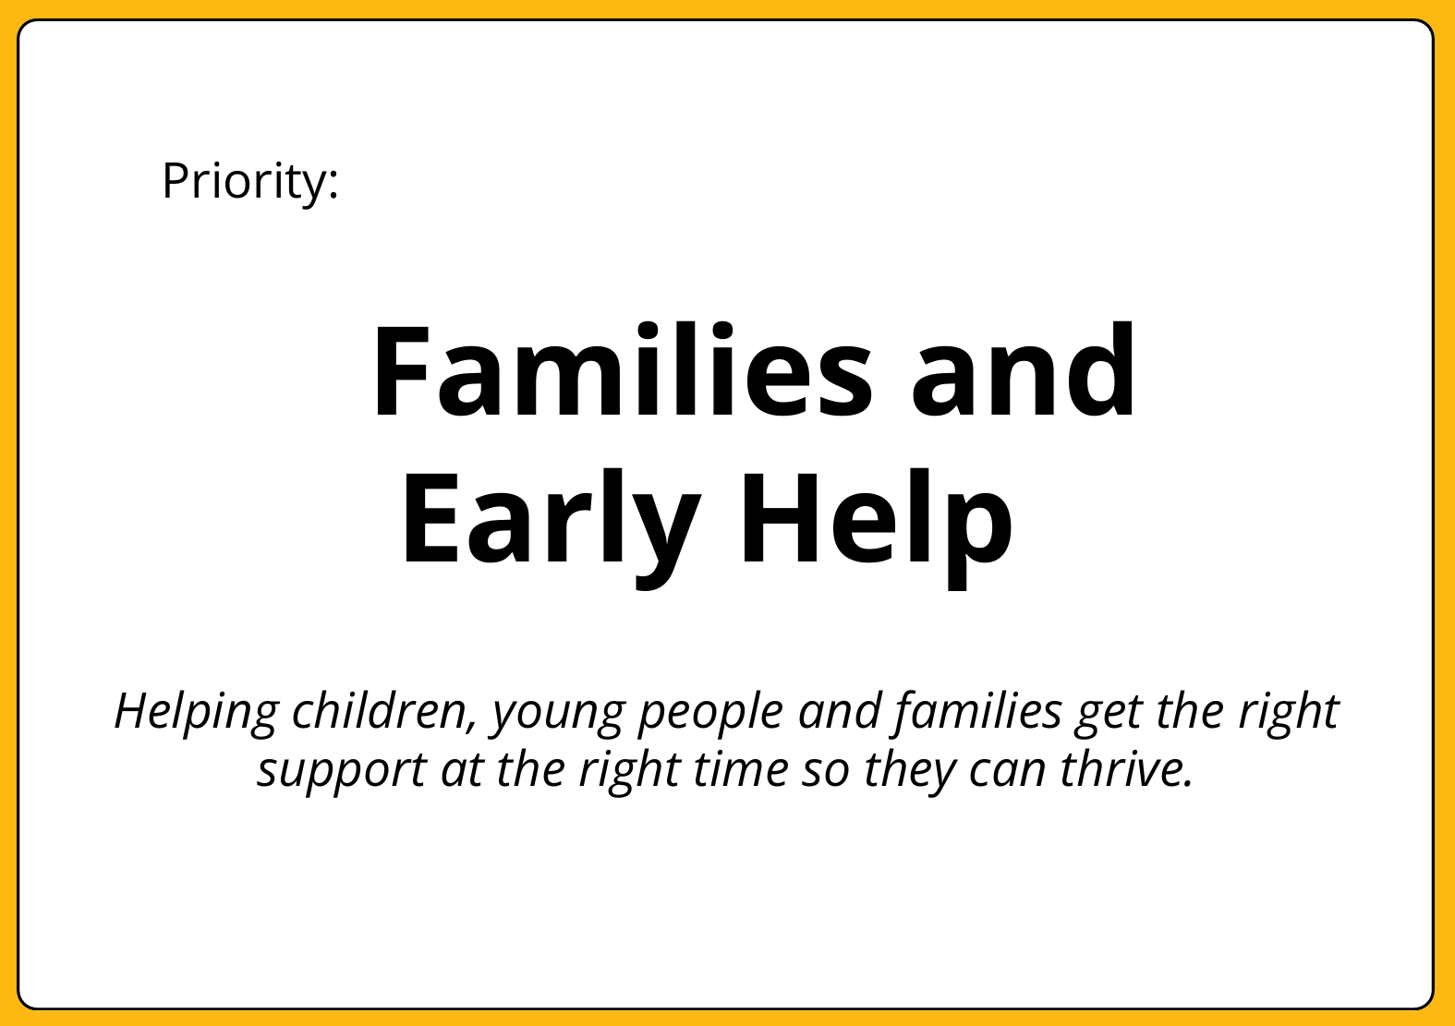
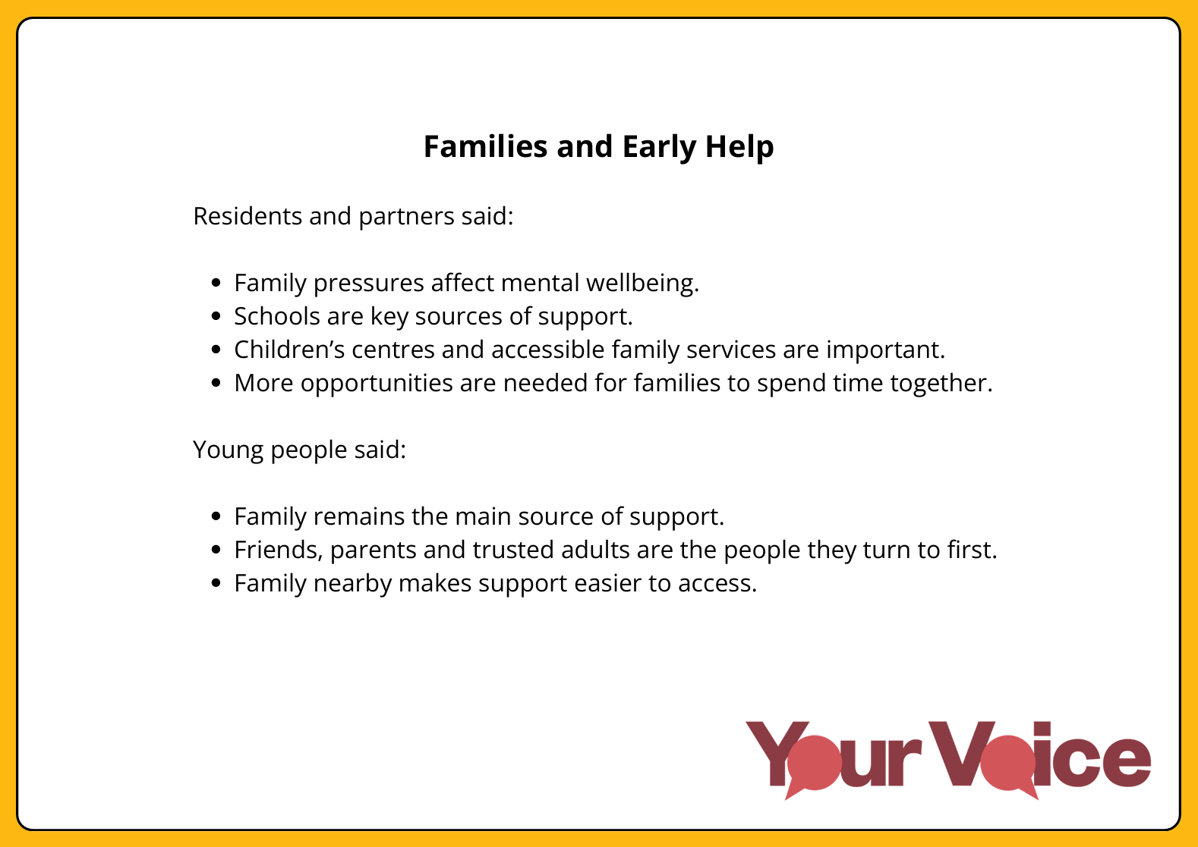
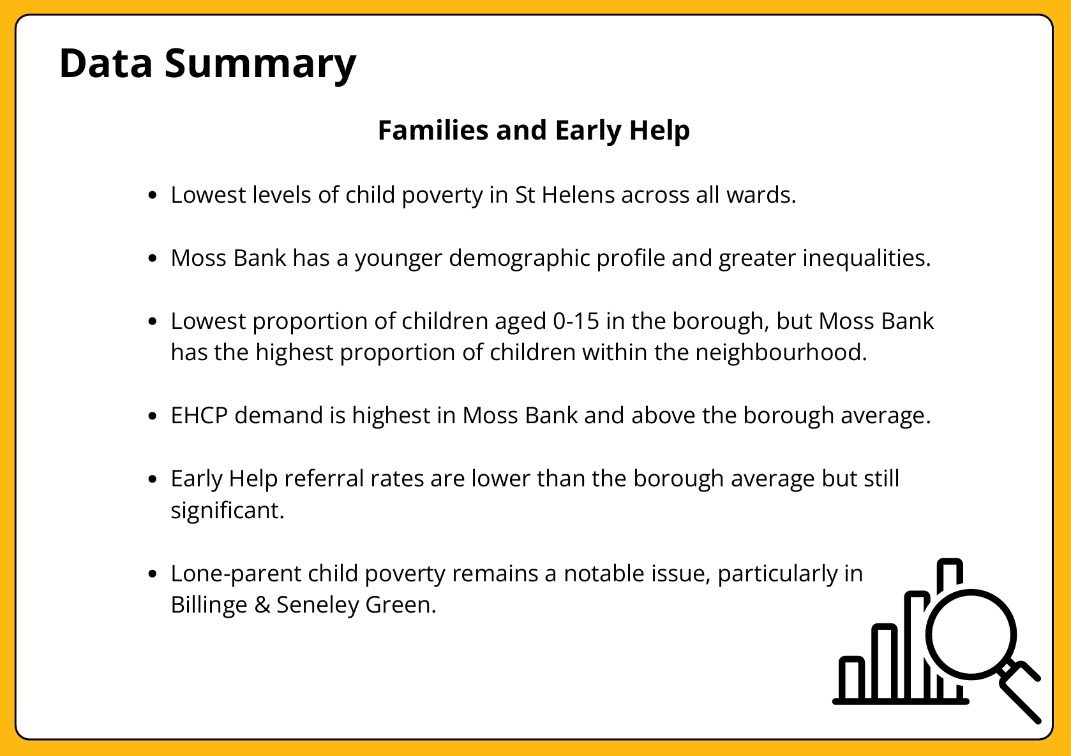
4.

Slide 18
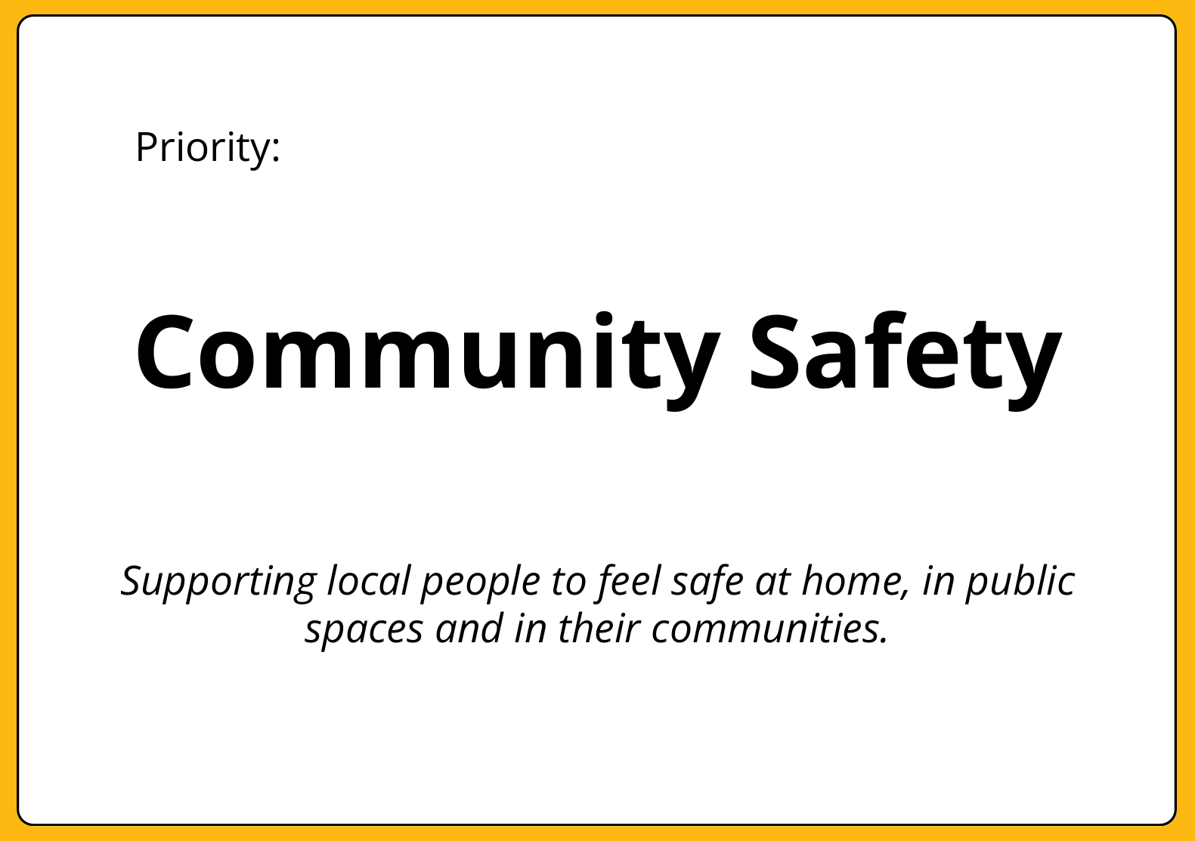
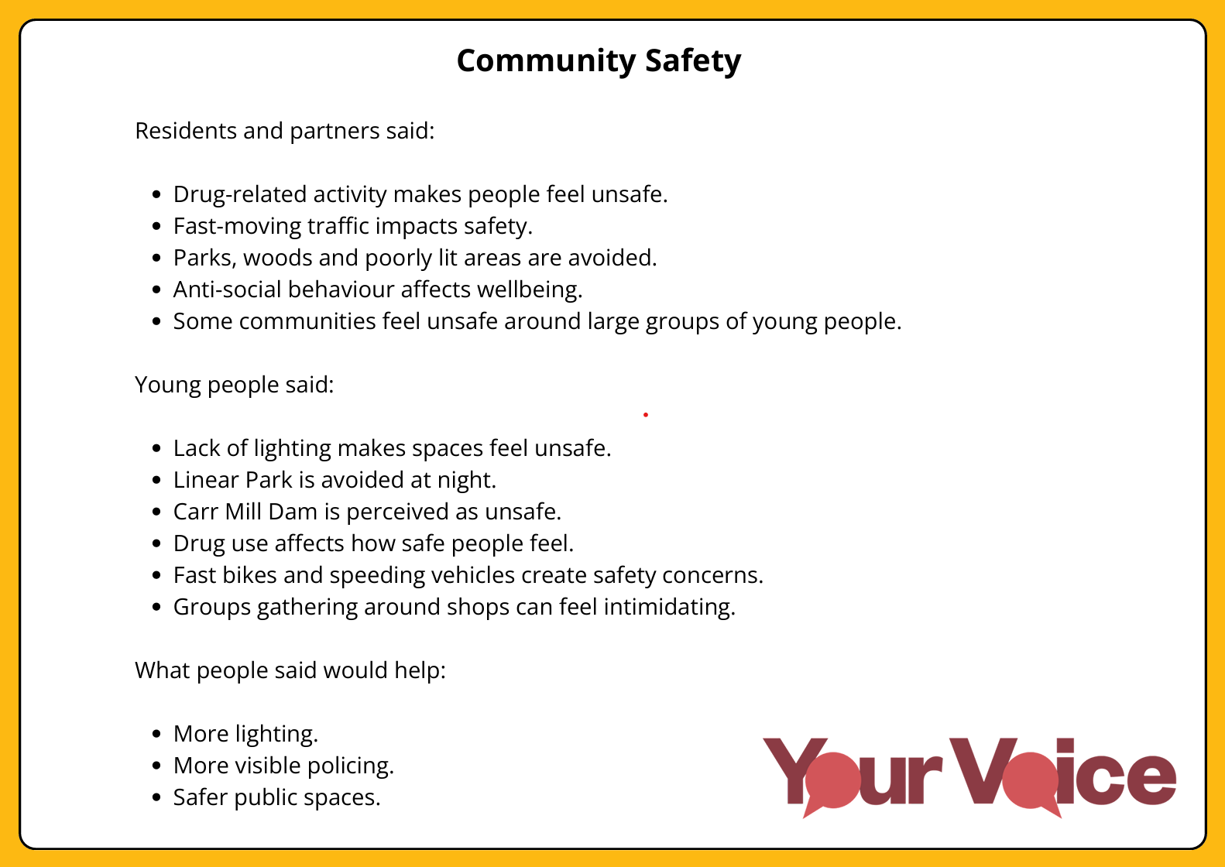
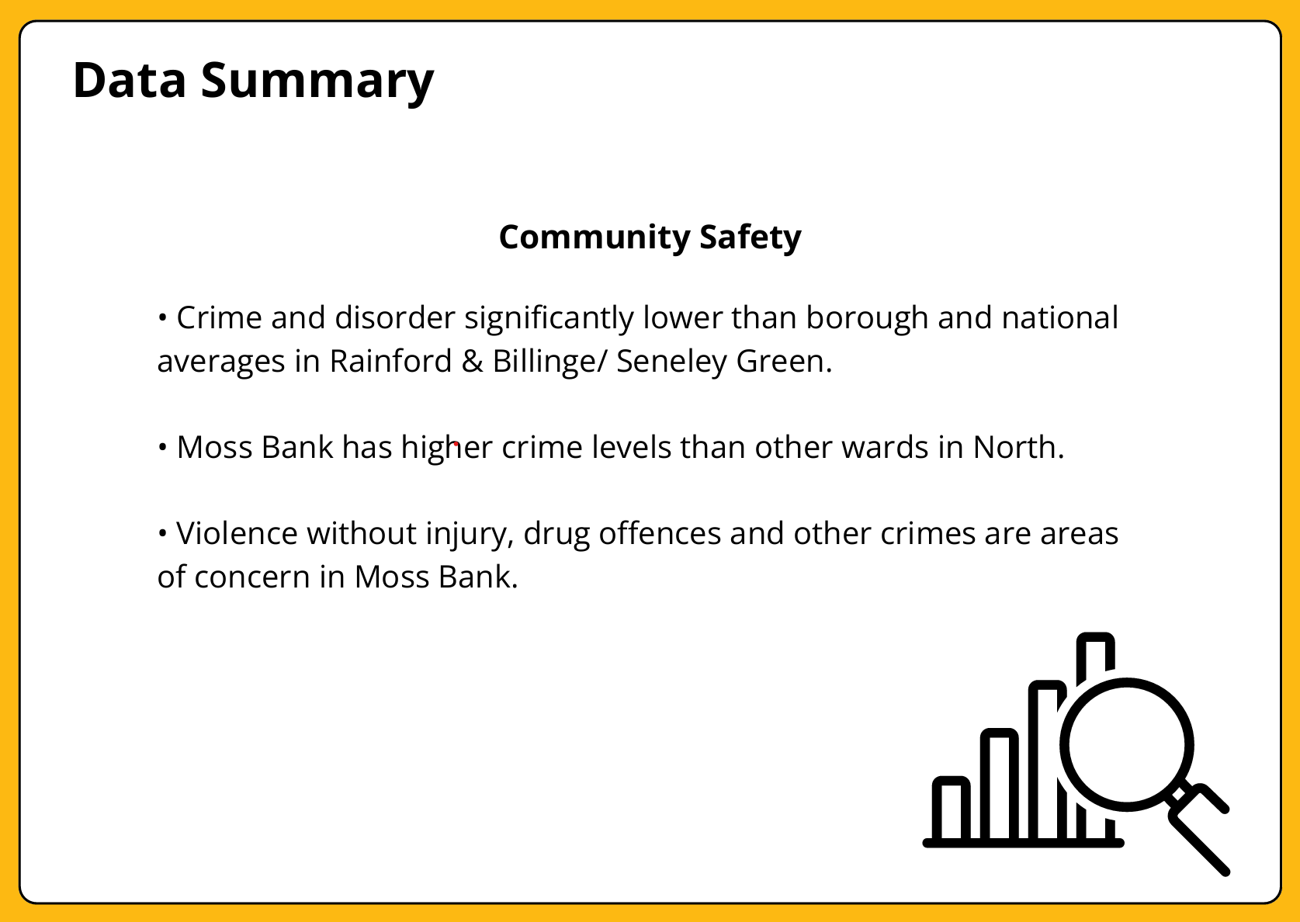
5.

Slide 19
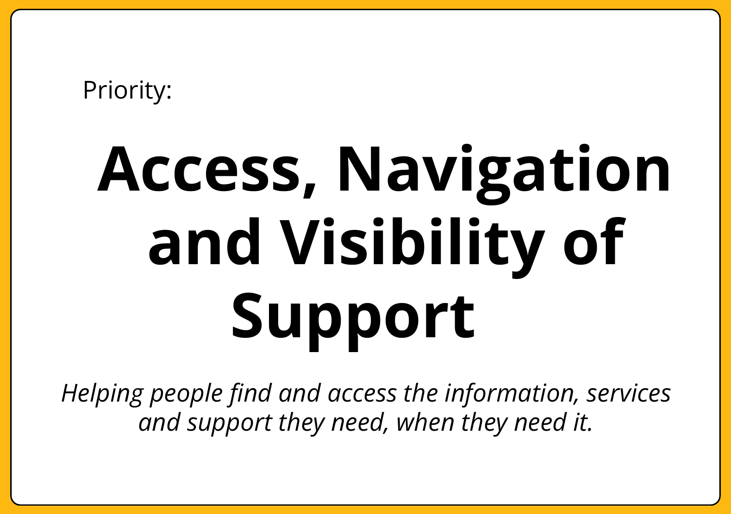
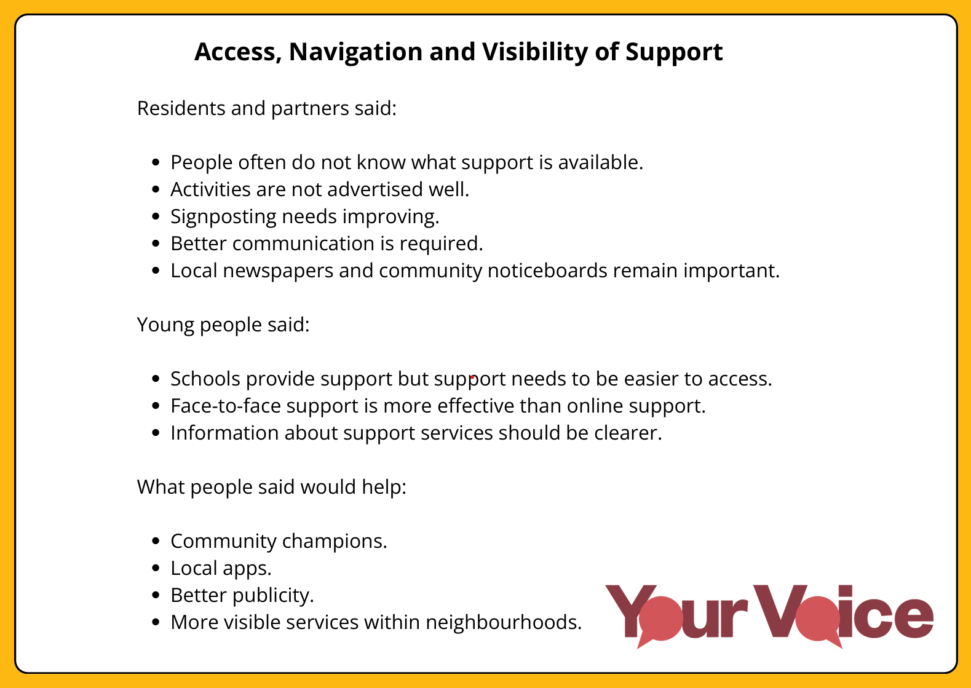
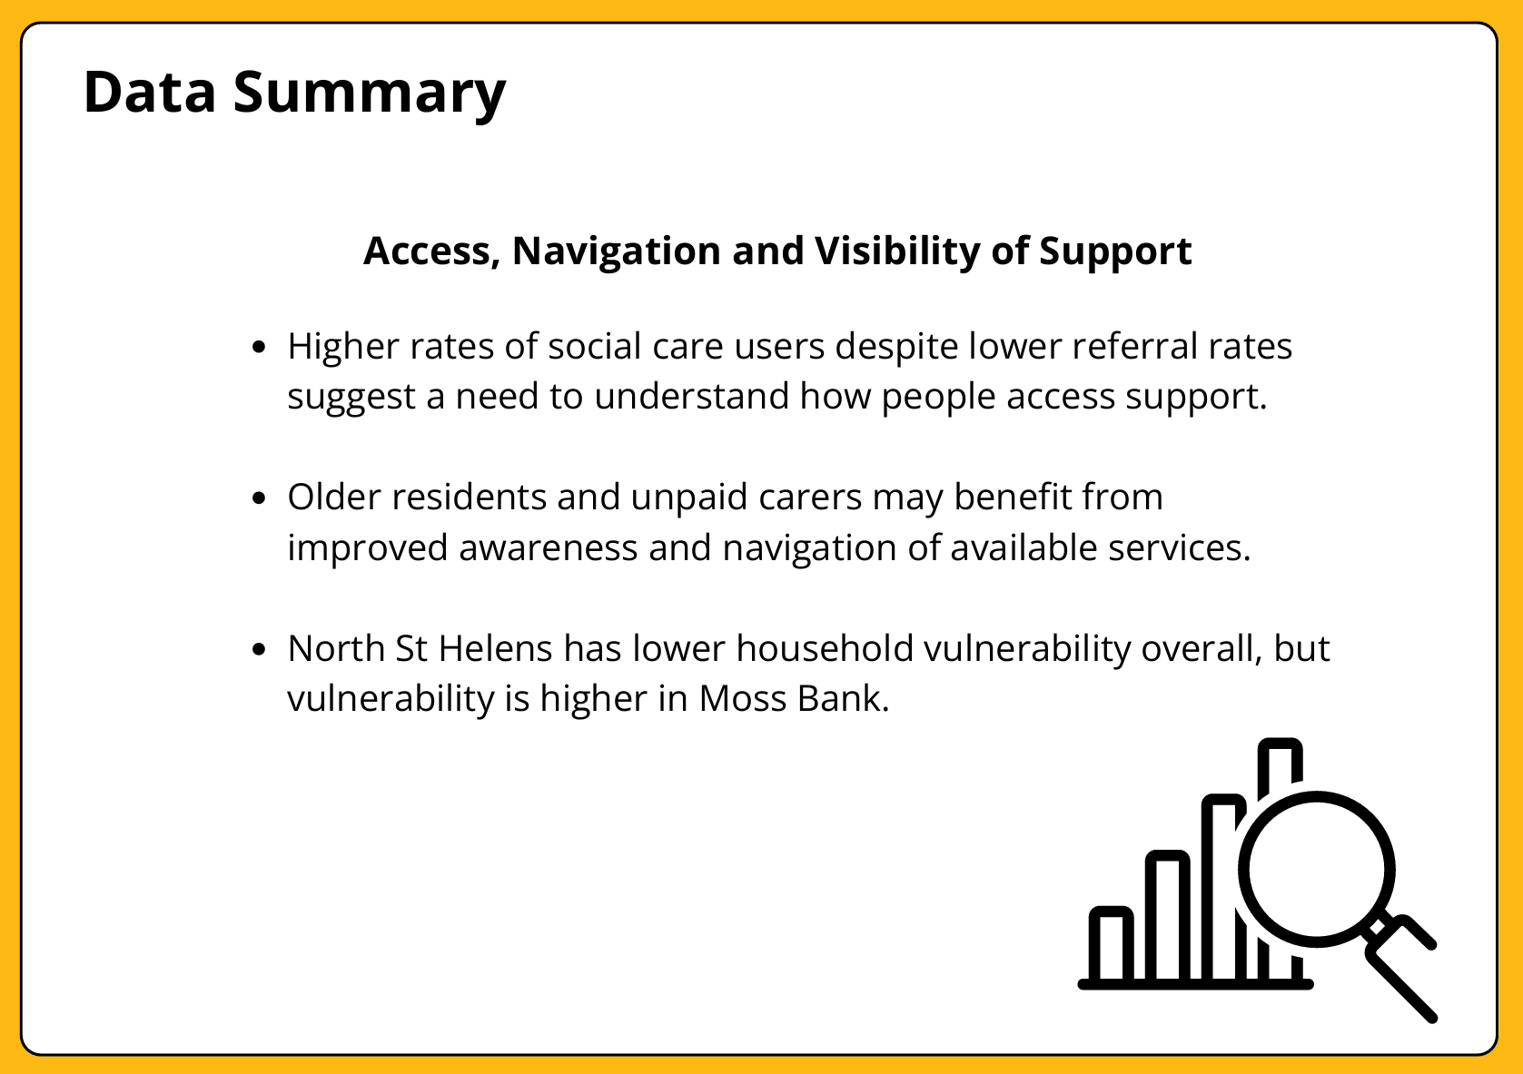
6.

Slide 20
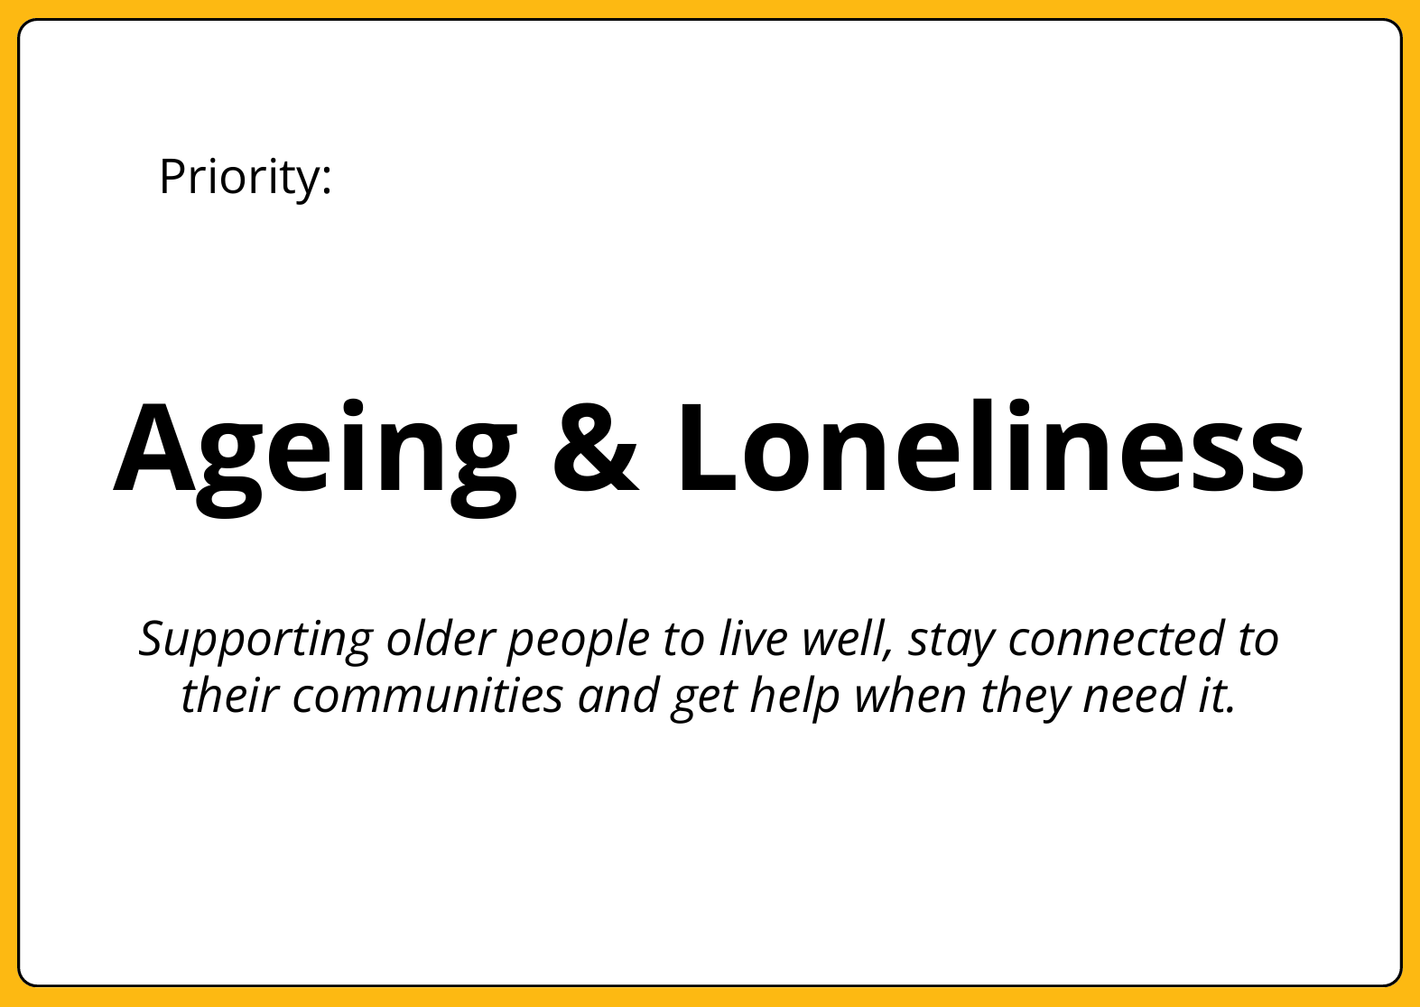
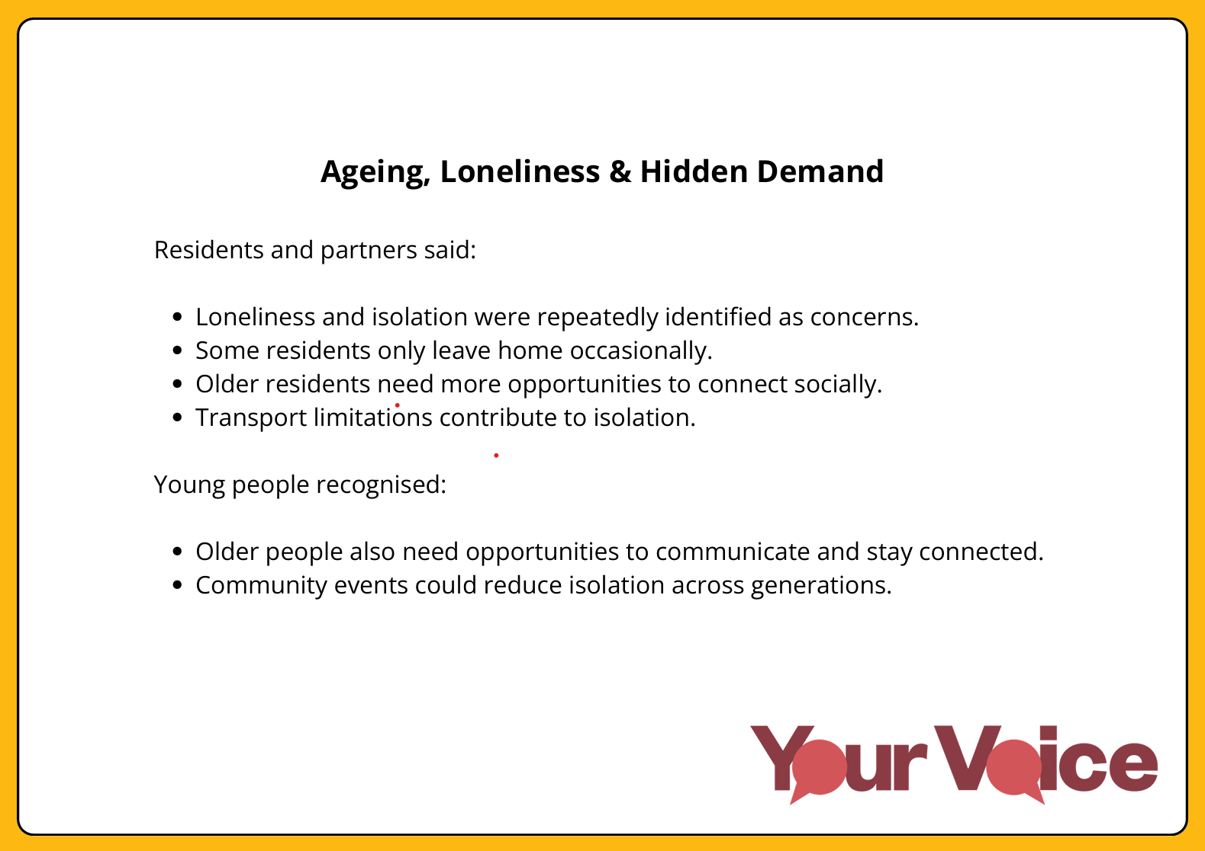
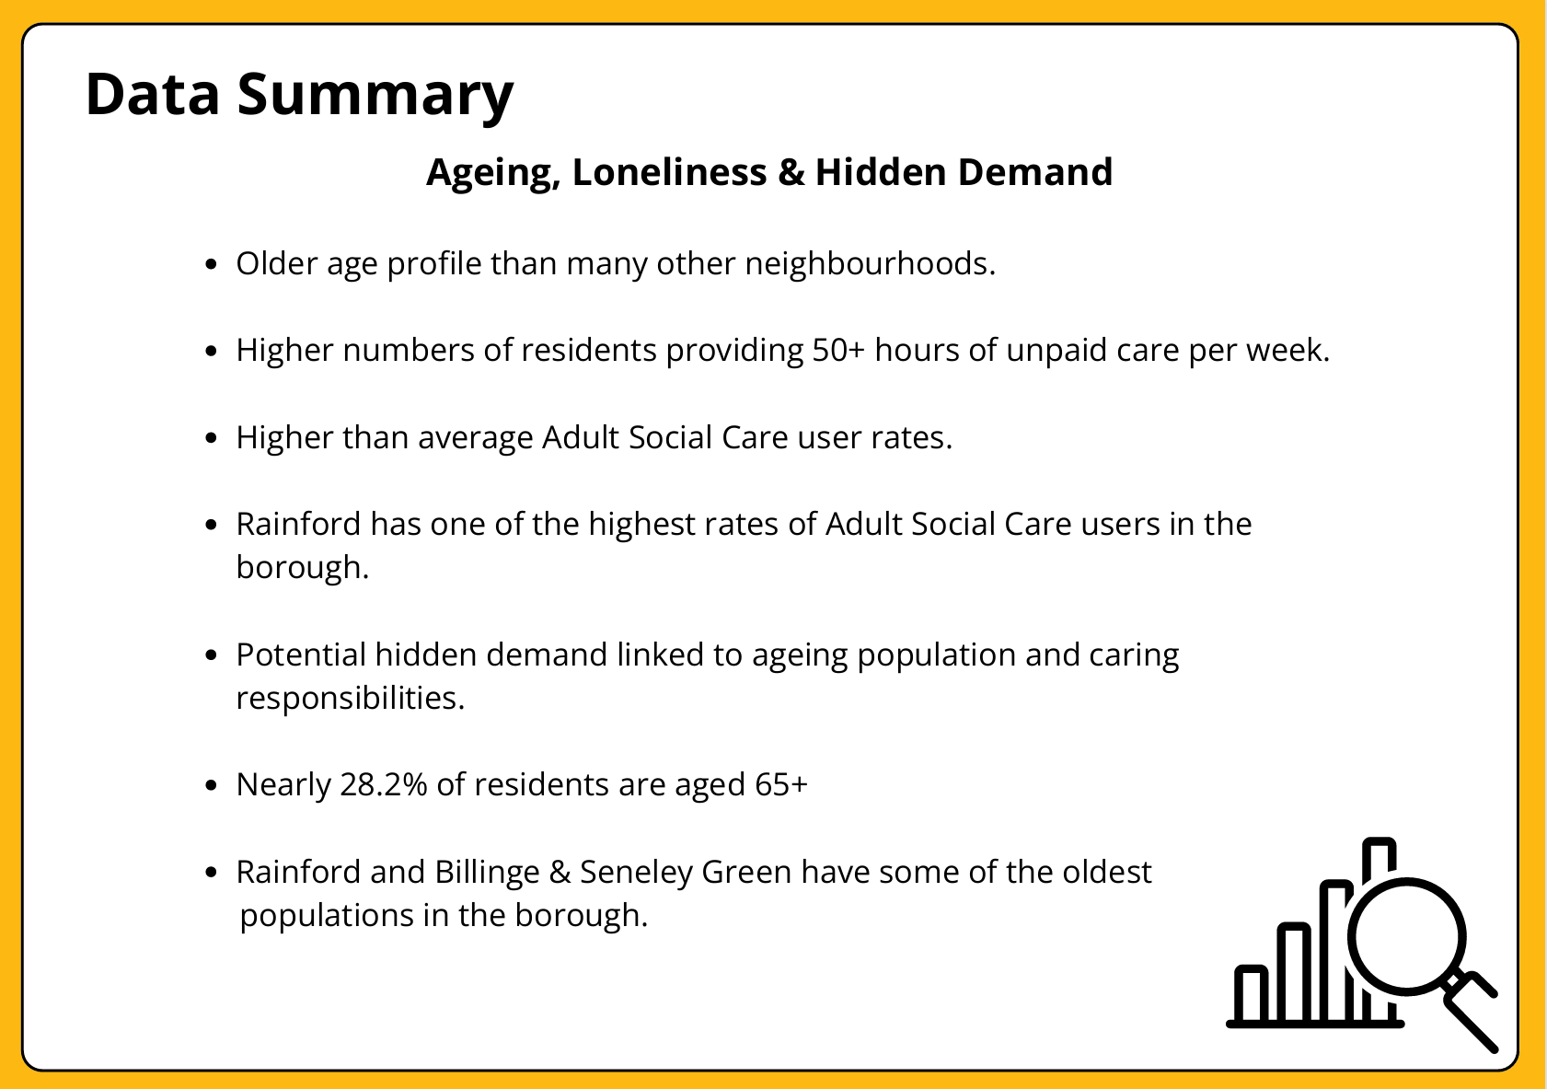
7.

Slide 21

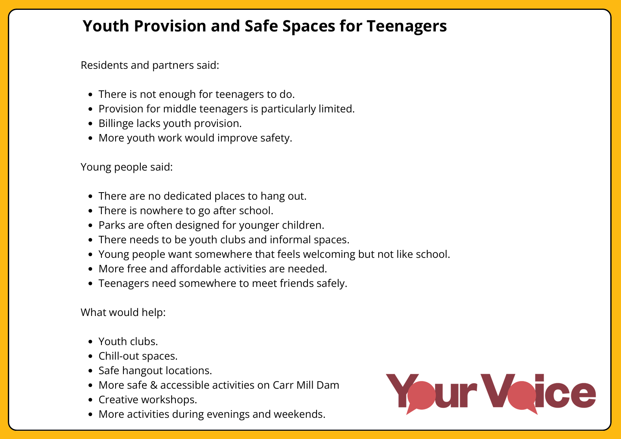
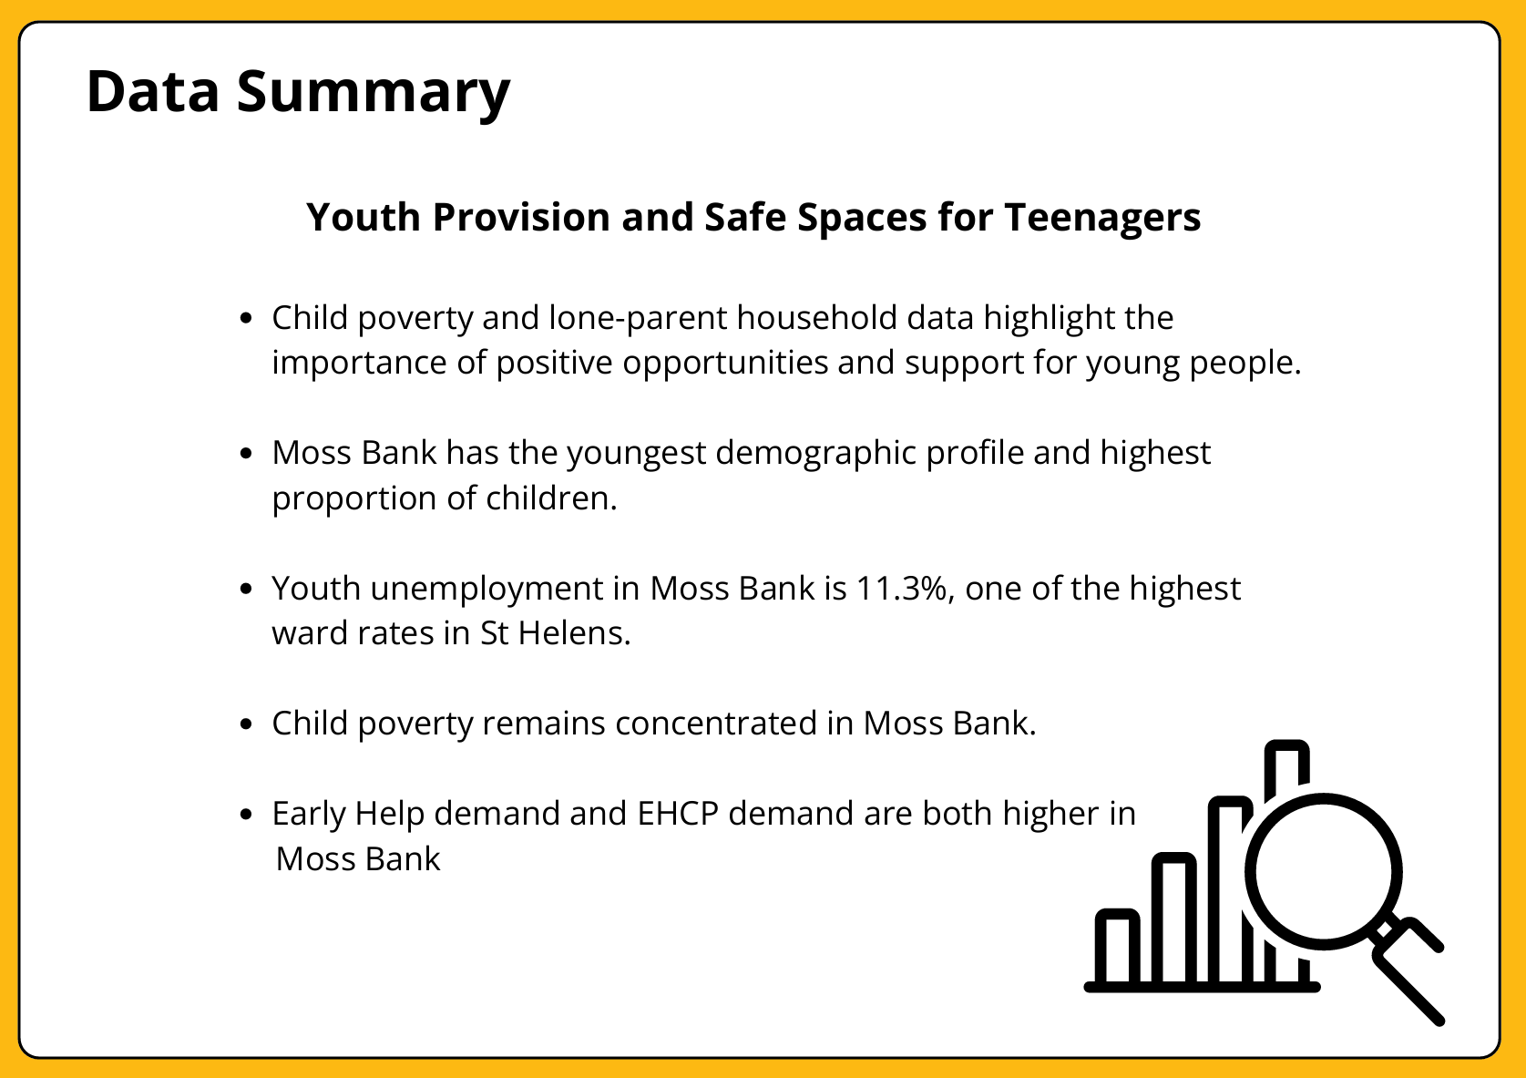
8.

Slide 22
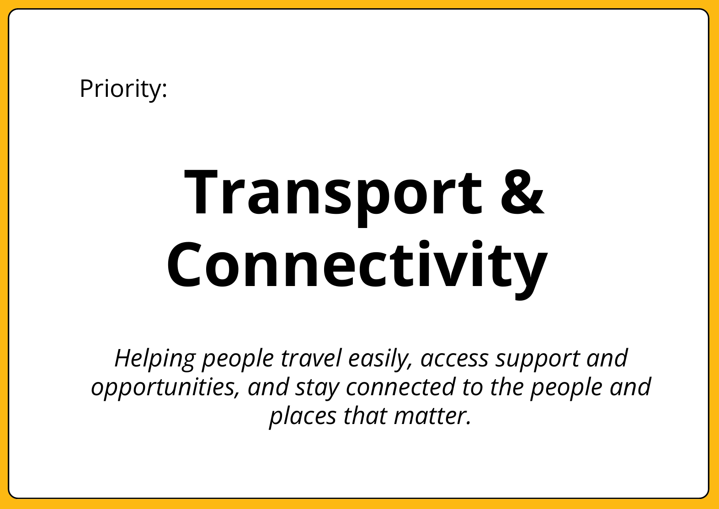
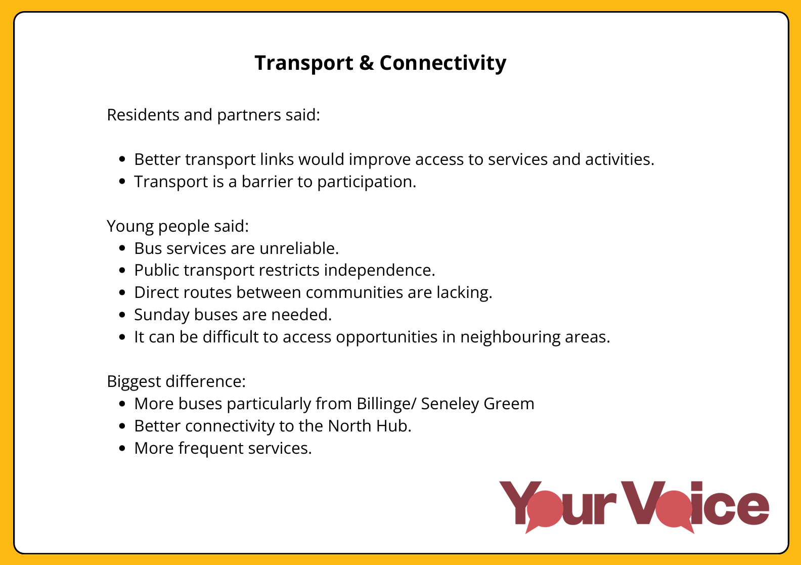
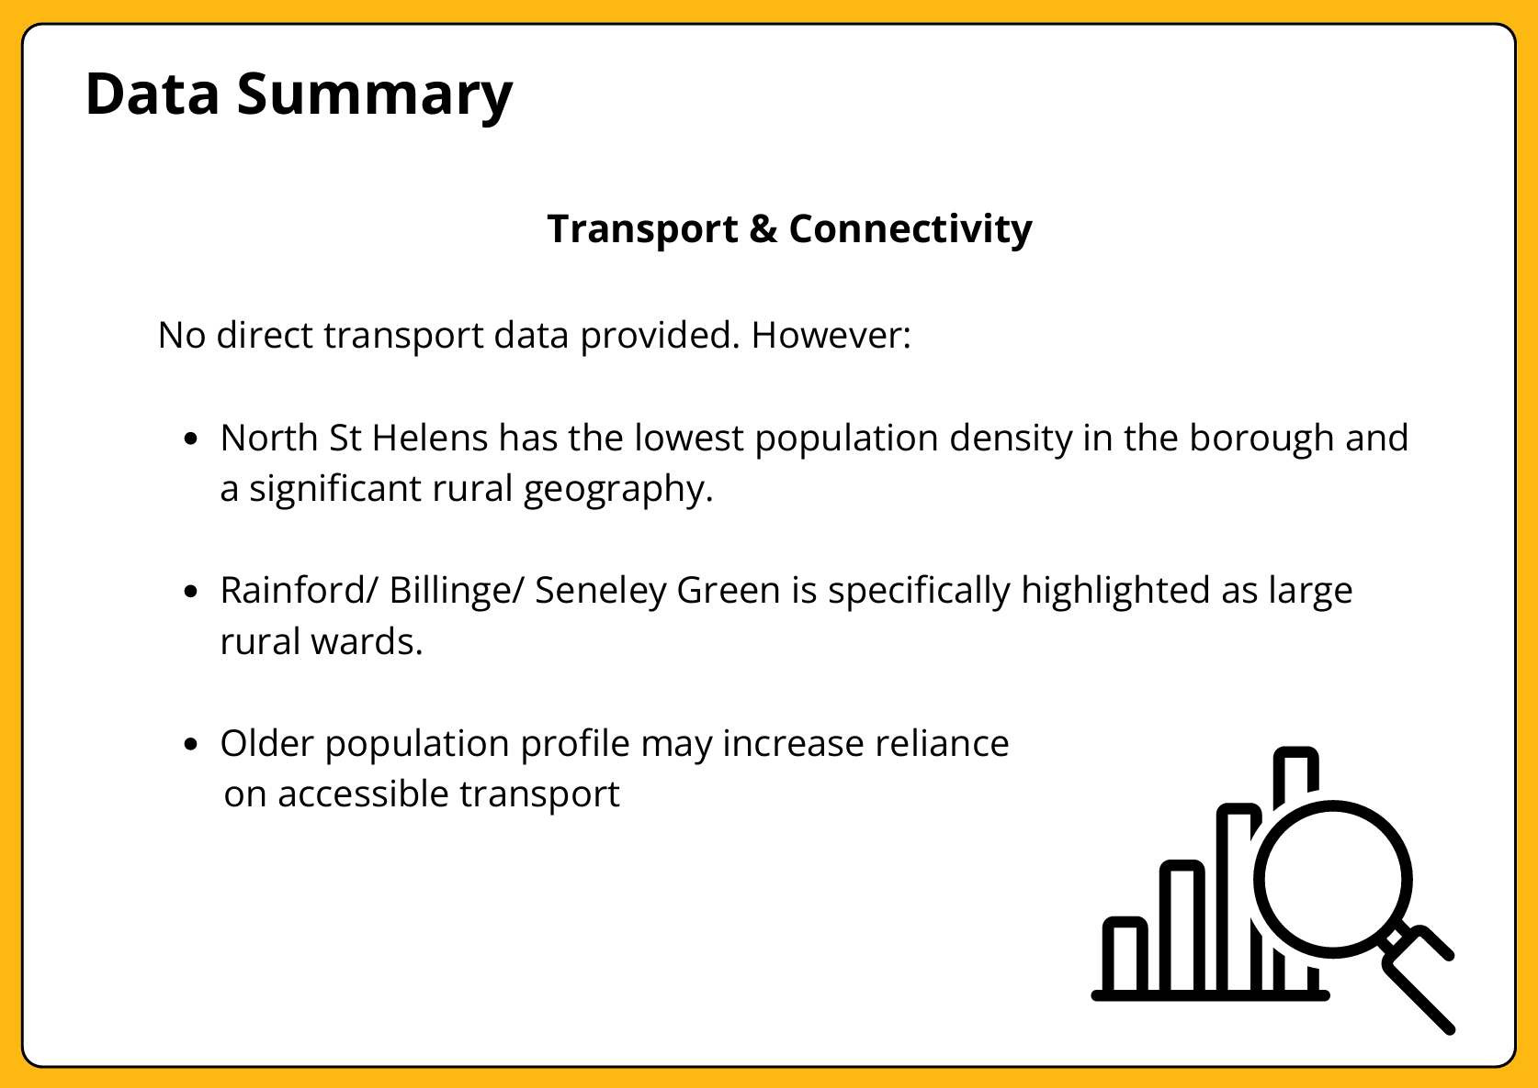
9.

Slide 23
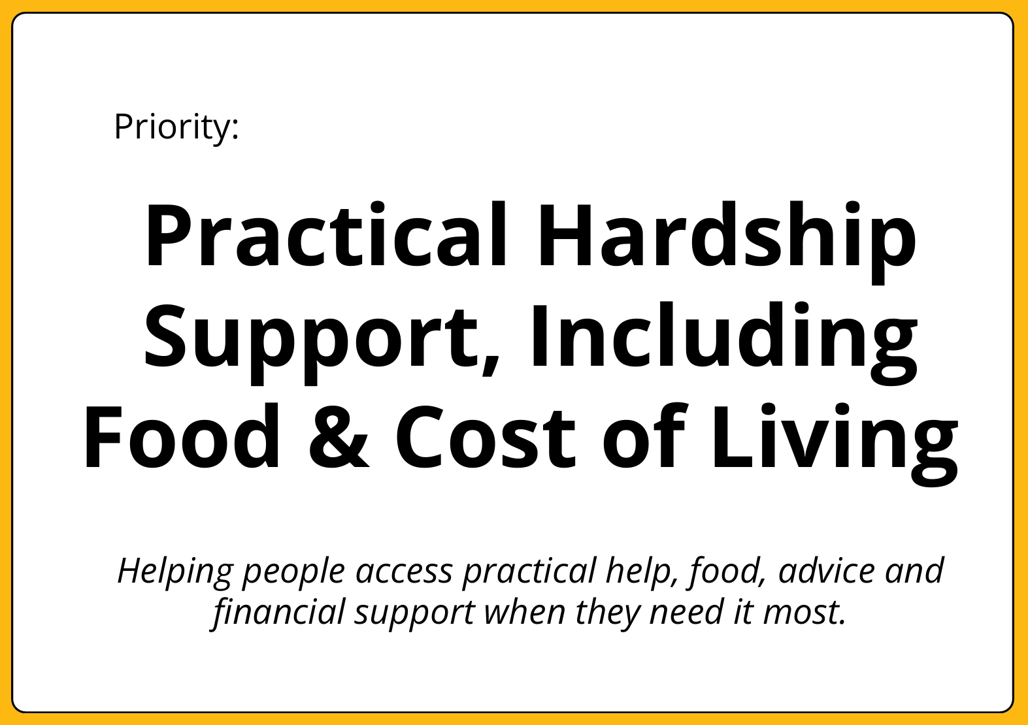
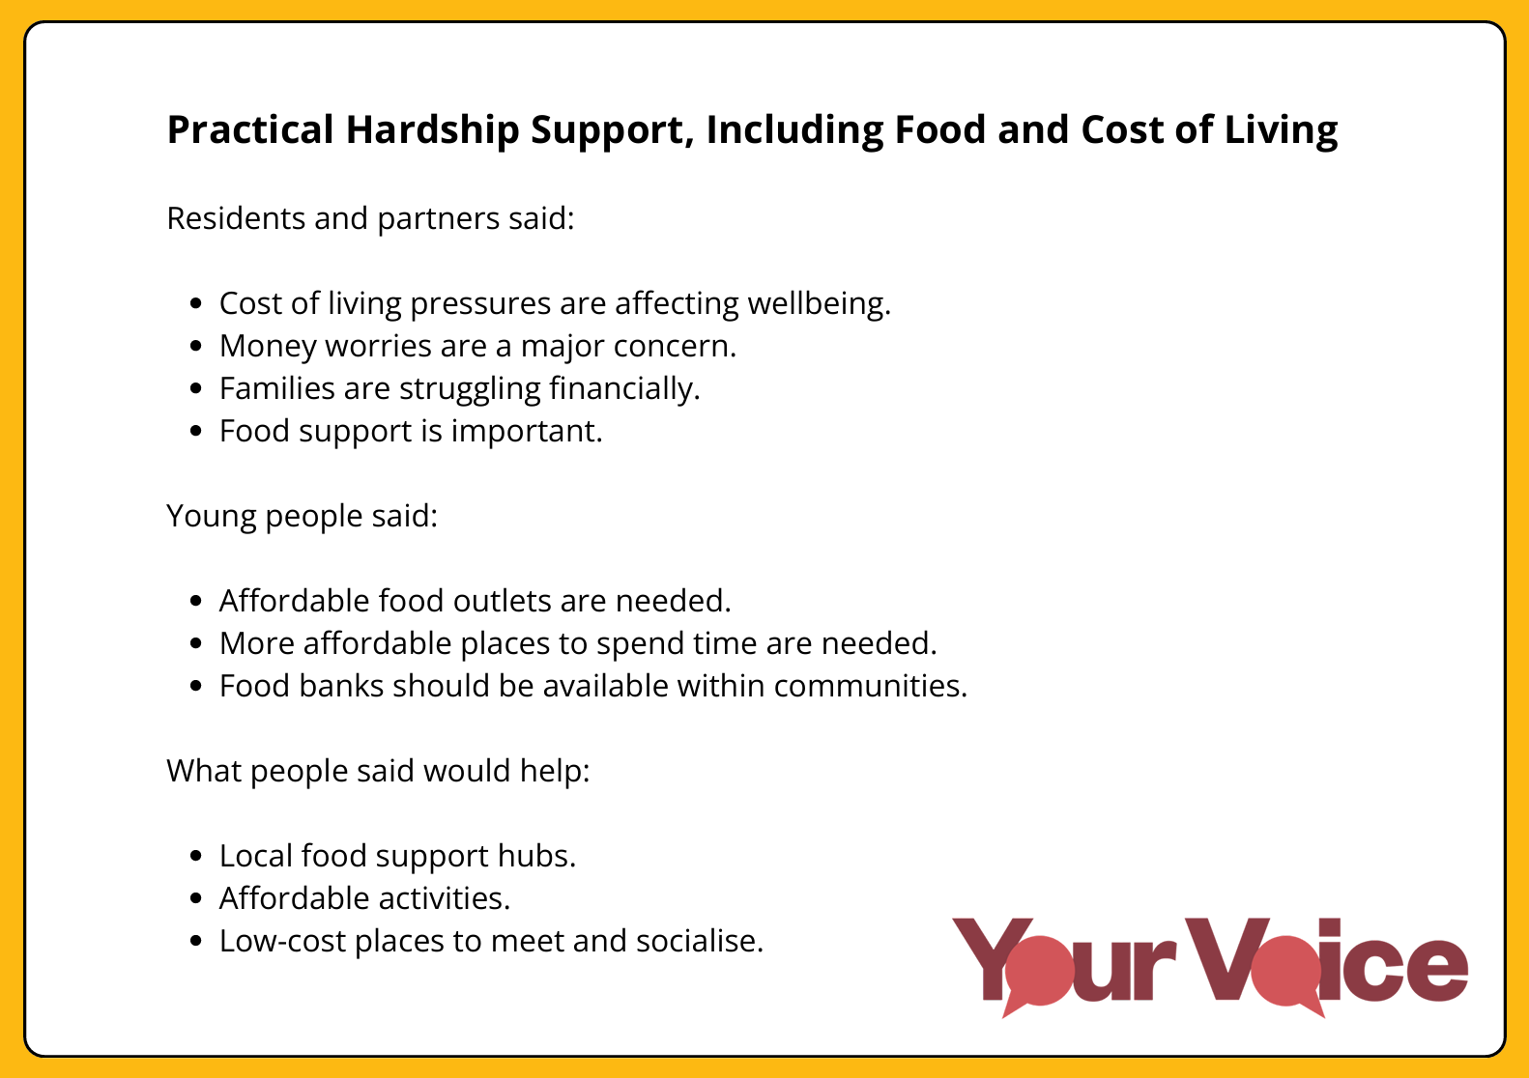
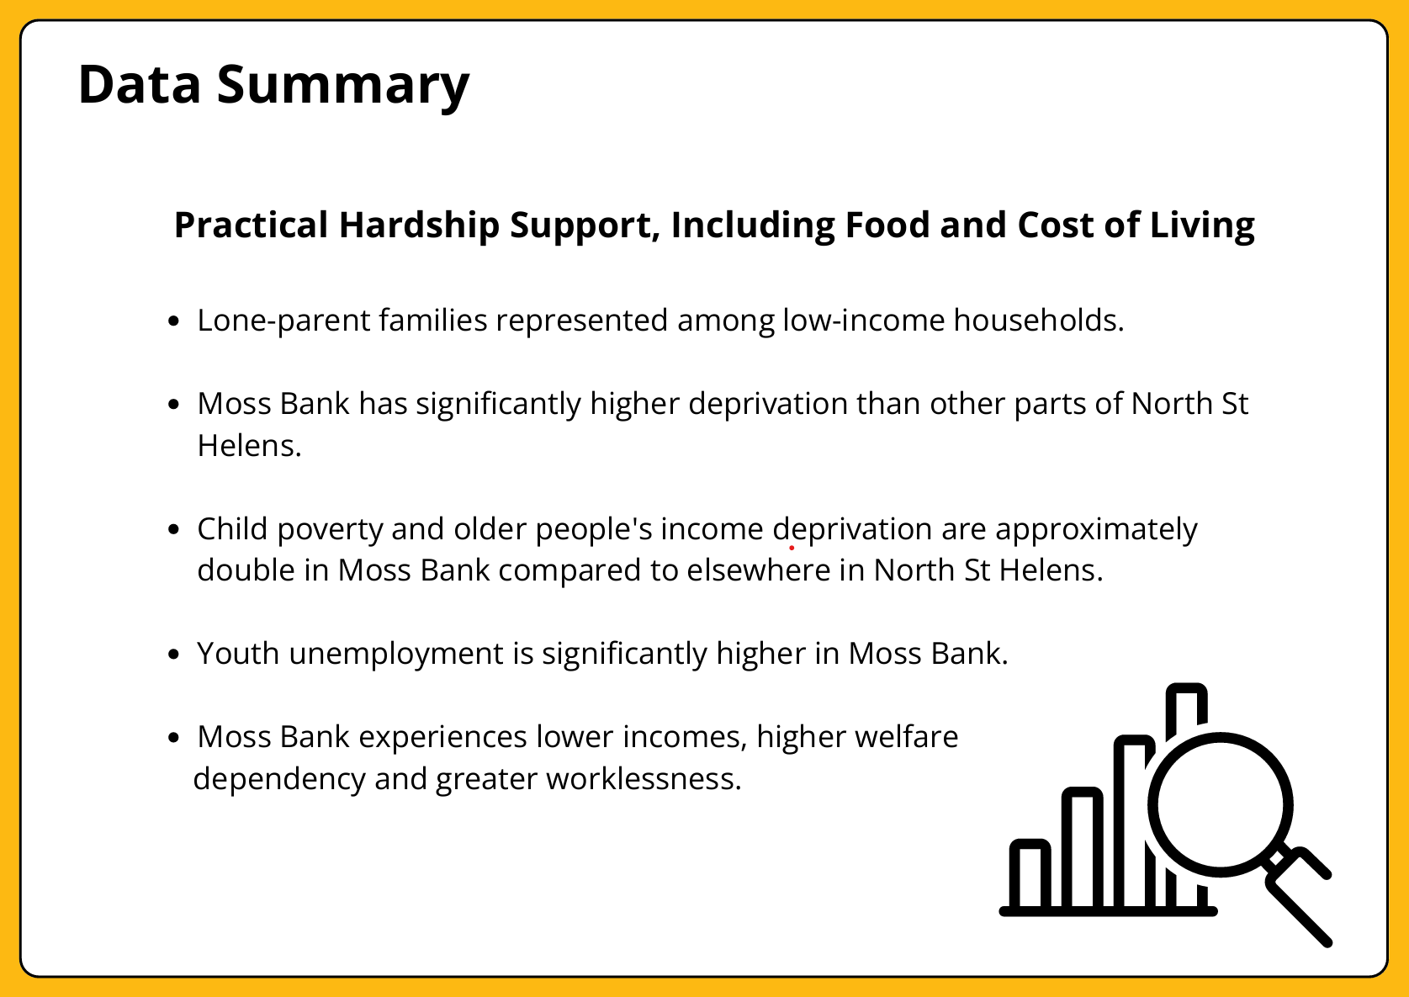
10.

Slide 24



11.

Slide 25



12.

Slide 26
Stakeholder Workshops

Slide 27






Stakeholder Workshop 1:
Multi Agency Rainford

Slide 28





Stakeholder Workshop 2:
Council Officers

Slide 29
Workshop 3: Questions at stations
What are we already doing to support this priority in North?
What is working well at the moment around this priority?
What is missing that would help us to deliver this priority?
What could we do differently to deliver this priority?
Who should be involved? What collaborations would help us to deliver this priority together?

Slide 30
Next steps…
Summarise stakeholder insights
Feedback to Programme Board

