Slide 1






Working together to achieve more
than we can achieve alone

Slide 2
What is the
Mental Health Alliance - Halton?
  The Mental Health Alliance - Halton, brings together all parts of our sector, with health and statutory partners.
  Improves mental health and wellbeing outcomes across Halton.
  Shares knowledge, resources and best practice.
  Strengthens referral pathways and collaboration.
Overall Vision:
A compassionate, inclusive and connected Halton
where nobody faces mental health challenges alone.

Slide 3
Why the Alliance Matters?
  Growing mental health need.
  Increased pressure on services.
  Need for joined-up support.
  Better use of local resources.
  Shared experience and resources.
  Stronger collective voice.
  Improved outcomes for Halton residents.
Mental health is everyone's business. By working together, we can provide earlier support, reduce crises, improve access to services and achieve better outcomes for local people.

Slide 4
Our Strategic Priorities
  Strengthen crisis support pathways.
  Invest in prevention and early intervention.
  Tackle stigma and inequalities.
  Support children and young people.
  Improve workforce resilience.
  Address wider determinants of health.
  Strengthen VCSFE sustainability and community-led support.

Slide 5
What we have achieved so far
✅ Established a borough-wide alliance & developed the strategy
✅ Mapped local services and identified key gaps and priorities
✅ Strengthened partnerships
✅ Created the SPACE Mental Health Kitemark and accreditation framework
✅ Showcased VCFSE services at the GP Educational Event at DCBL Stadium
✅ Hosted the ‘What Keeps Me Well’ Mental Health Conference
✅ Increased collaboration between NHS, Primary Care and the VCFSE sector
✅ Amplified the voice of local organisations and people with lived experience
✅ Developed a collective voice to influence local mental health priorities
✅ Built strong foundations for future collaboration, innovation and system change

Slide 6
We need you!
What are the benefits
of joining MHAH
Joining will:
  Raise awareness of your organisation and services.
  Build partnerships and referral opportunities.
  Access shared knowledge, training and resources.
  Influence local decision-making and strategy.
  Develop joint projects and funding opportunities.
  Together we can create a stronger, more connected mental health support system for Halton.

Slide 7
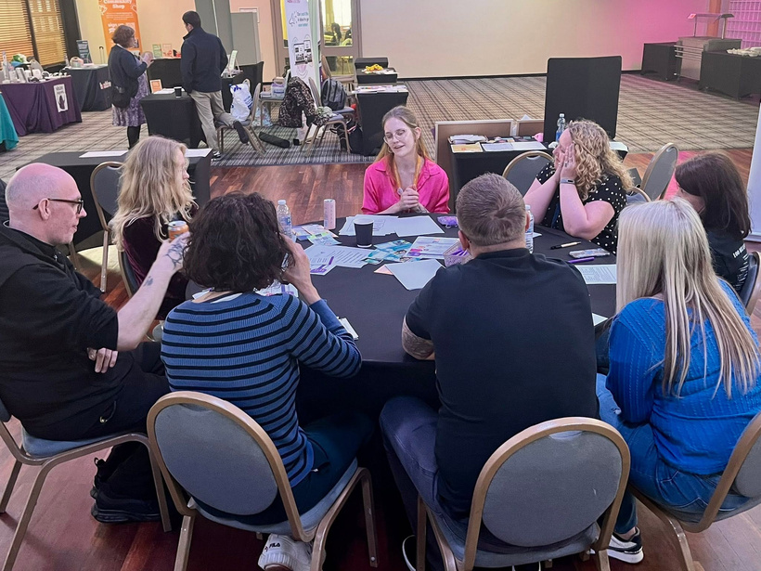
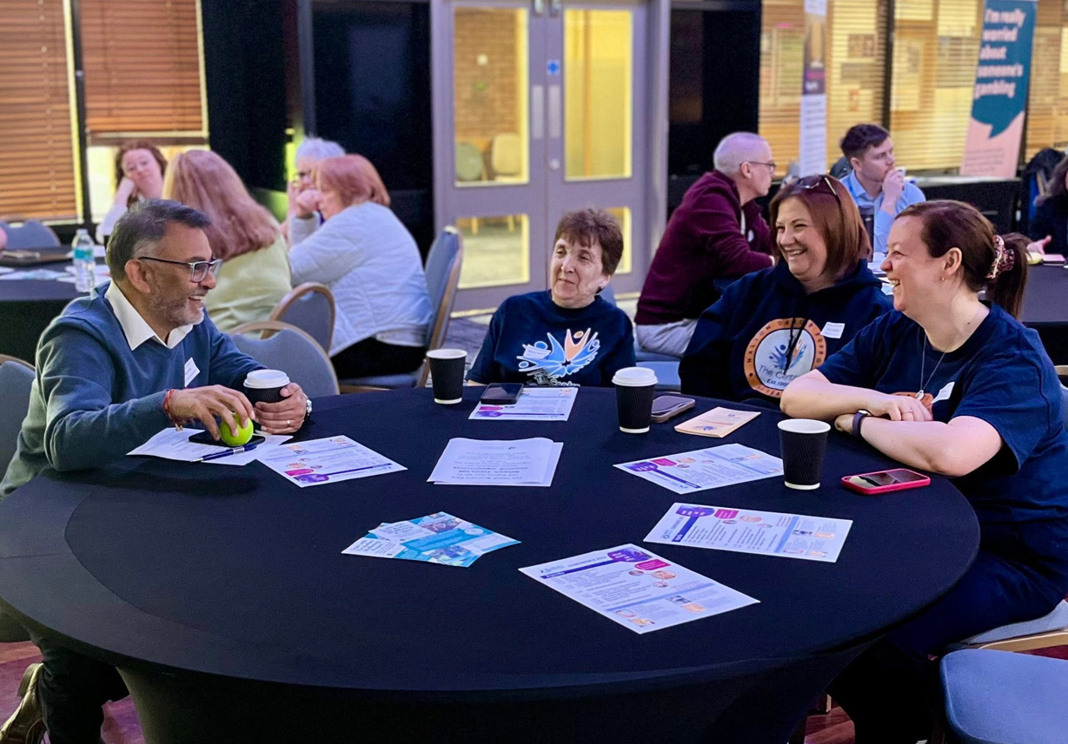
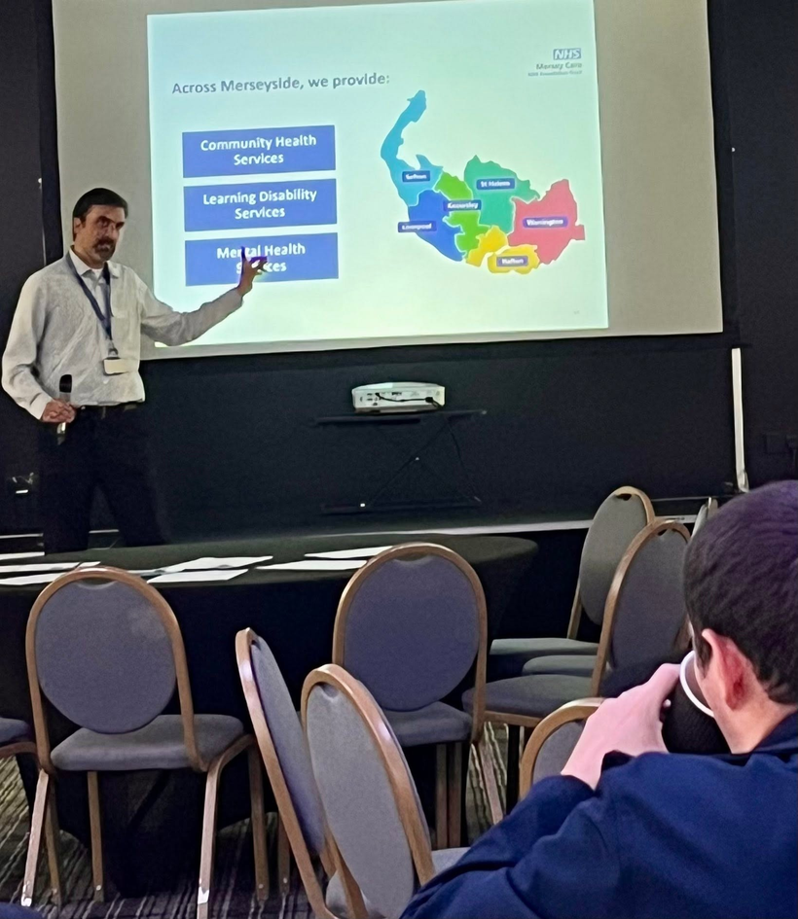
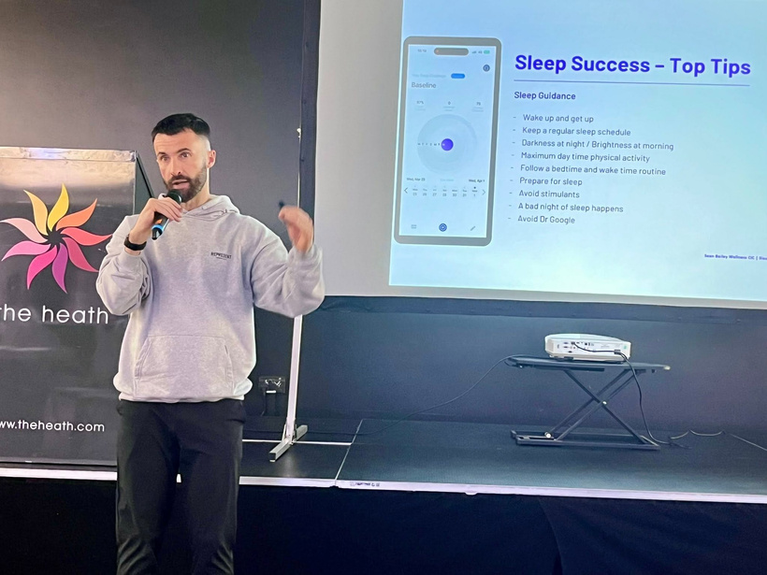
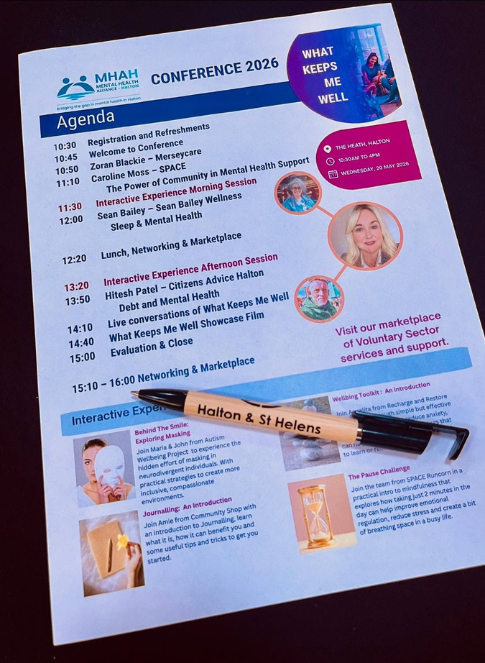
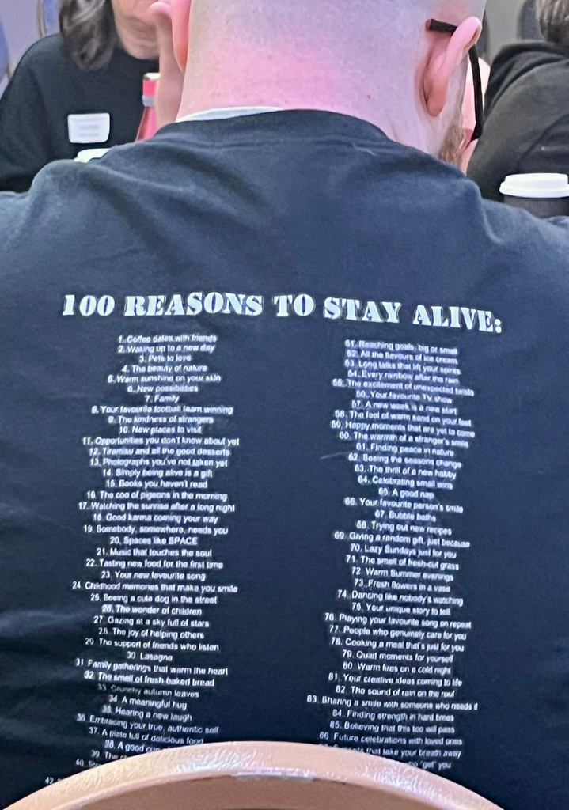
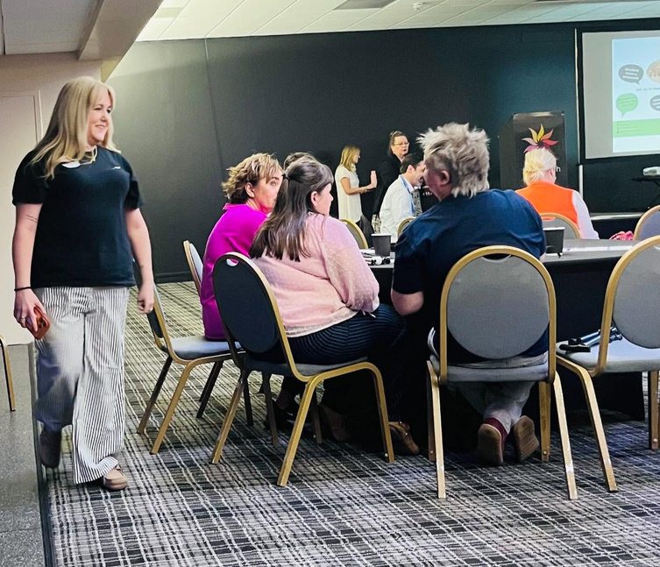
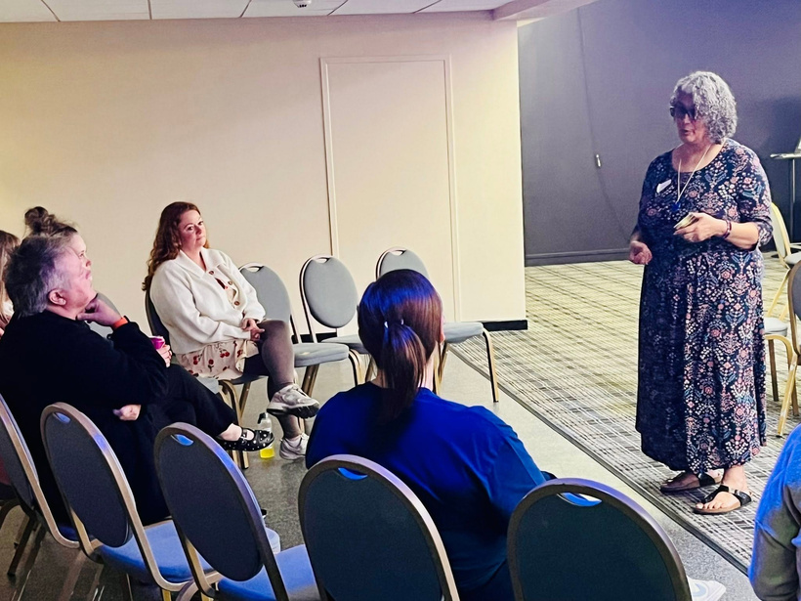

Slide 8


How to get involved
We are looking for all types of groups and organisations in all shapes and sizes.
If your service supports wellbeing and mental health from light touch prevention through to specific mental health intervention services, we need you!
Join us on 16th July from 9am - 11am for a breakfast meeting here at H&SH VCA, where we can enjoy a breakfast together, discuss the Mental Health Alliance - Halton, further and hopefully you will join us!

Slide 9
Over to Caroline from Space...

