Slide 1
Children and Young Peoples Voice and Participation in Halton

Slide 2

Introducing THE Lundy MODEL OF PARTICPATION
Notes:
What is the Lundy Model of Participation?
A framework for involving children and young people in decisions
Developed by Professor Laura Lundy
Based on Article 12 of the UN Convention on the Rights of the Child
In a nutshell it’s a simple way to make sure children, and young people are meaningfully involved in decisions that affect them.
It is based on four key elements Space, Voice, Audience and Influence.
The model helps ensure participation is real, meaningful and not just a tick‑box exercise.

Slide 3
The Four Elements of the Lundy Model
Space
Safe and inclusive opportunities to express views
Voice
Support to express views freely
Audience
Views listened to by decision-makers
Influence
Views taken seriously and acted upon
Notes:
The Lundy Model is made up of four connected elements:
Space – this provides children with safe, inclusive, and appropriate opportunities to share their views.
Voice – children are supported to express their views in ways that work for them (not just talking or writing).
Audience – the right people listen to children, including those who can make decisions.
Influence – children’s views are taken seriously, responded to, and help inform decisions.
Children may not always get what they ask for, but they should always receive honest feedback about how their views were used.
Together, these four elements help organisations ensure participation is meaningful, respectful, and not tokenistic.

Slide 4

Why You Should Use the Lundy Model
Structured Participation Process
  The Lundy Model offers a clear, step-by-step framework for effective and consistent participation activities.
Legal and Ethical Compliance
  The model helps organizations meet legal duties, including those from the UN Convention on the Rights of the Child.
Promotes Respect and Inclusion
  It fosters a culture where children are active participants, enhancing engagement and positive outcomes.
Supports Accountability and Feedback
  Emphasizing transparency, children are informed how their views influence decisions, building trust.
Notes:
Why use the Lundy Model?
It provides a clear and simple structure for involving children and young people.
It helps organisations meet legal and policy duties, including children’s rights.
It promotes a culture of respect and inclusion, valuing children’s views.
It improves trust and engagement by giving feedback on what changed.
It is widely recognised, making participation consistent and credible.

Slide 5
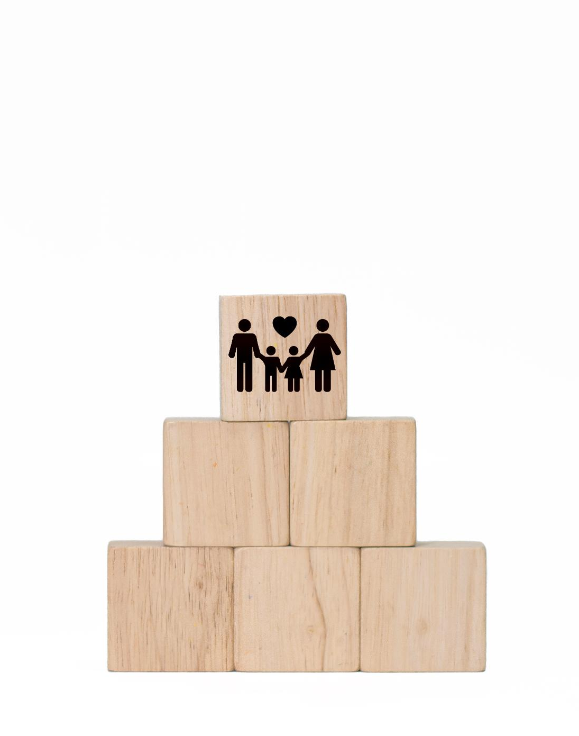
Benefits of Using the Lundy Model
Meaningful Participation
  The Lundy Model ensures participation is meaningful, moving beyond tokenistic approaches to honest and transparent engagement.
Improved Decision-Making
  Including children's insights leads to decisions that are more relevant, effective, and responsive to their needs.
Support for Children’s Rights
  The model puts the UNCRC into practice, strengthening ethical standards and respecting children as rights-holders.
Building Trust and Flexibility
  The model builds trust and positive relationships and is flexible for use in various contexts like schools and healthcare.
Notes:
Benefits of using the Lundy Model
It helps make participation meaningful, not tokenistic.
Children’s views are used to inform decisions, not just collected.
It leads to better decisions by including children’s real experiences.
It supports children’s rights and shows a commitment to fair practice.
It helps build trust, confidence, and ongoing engagement.
It is flexible and easy to use across different services and settings.

Slide 6
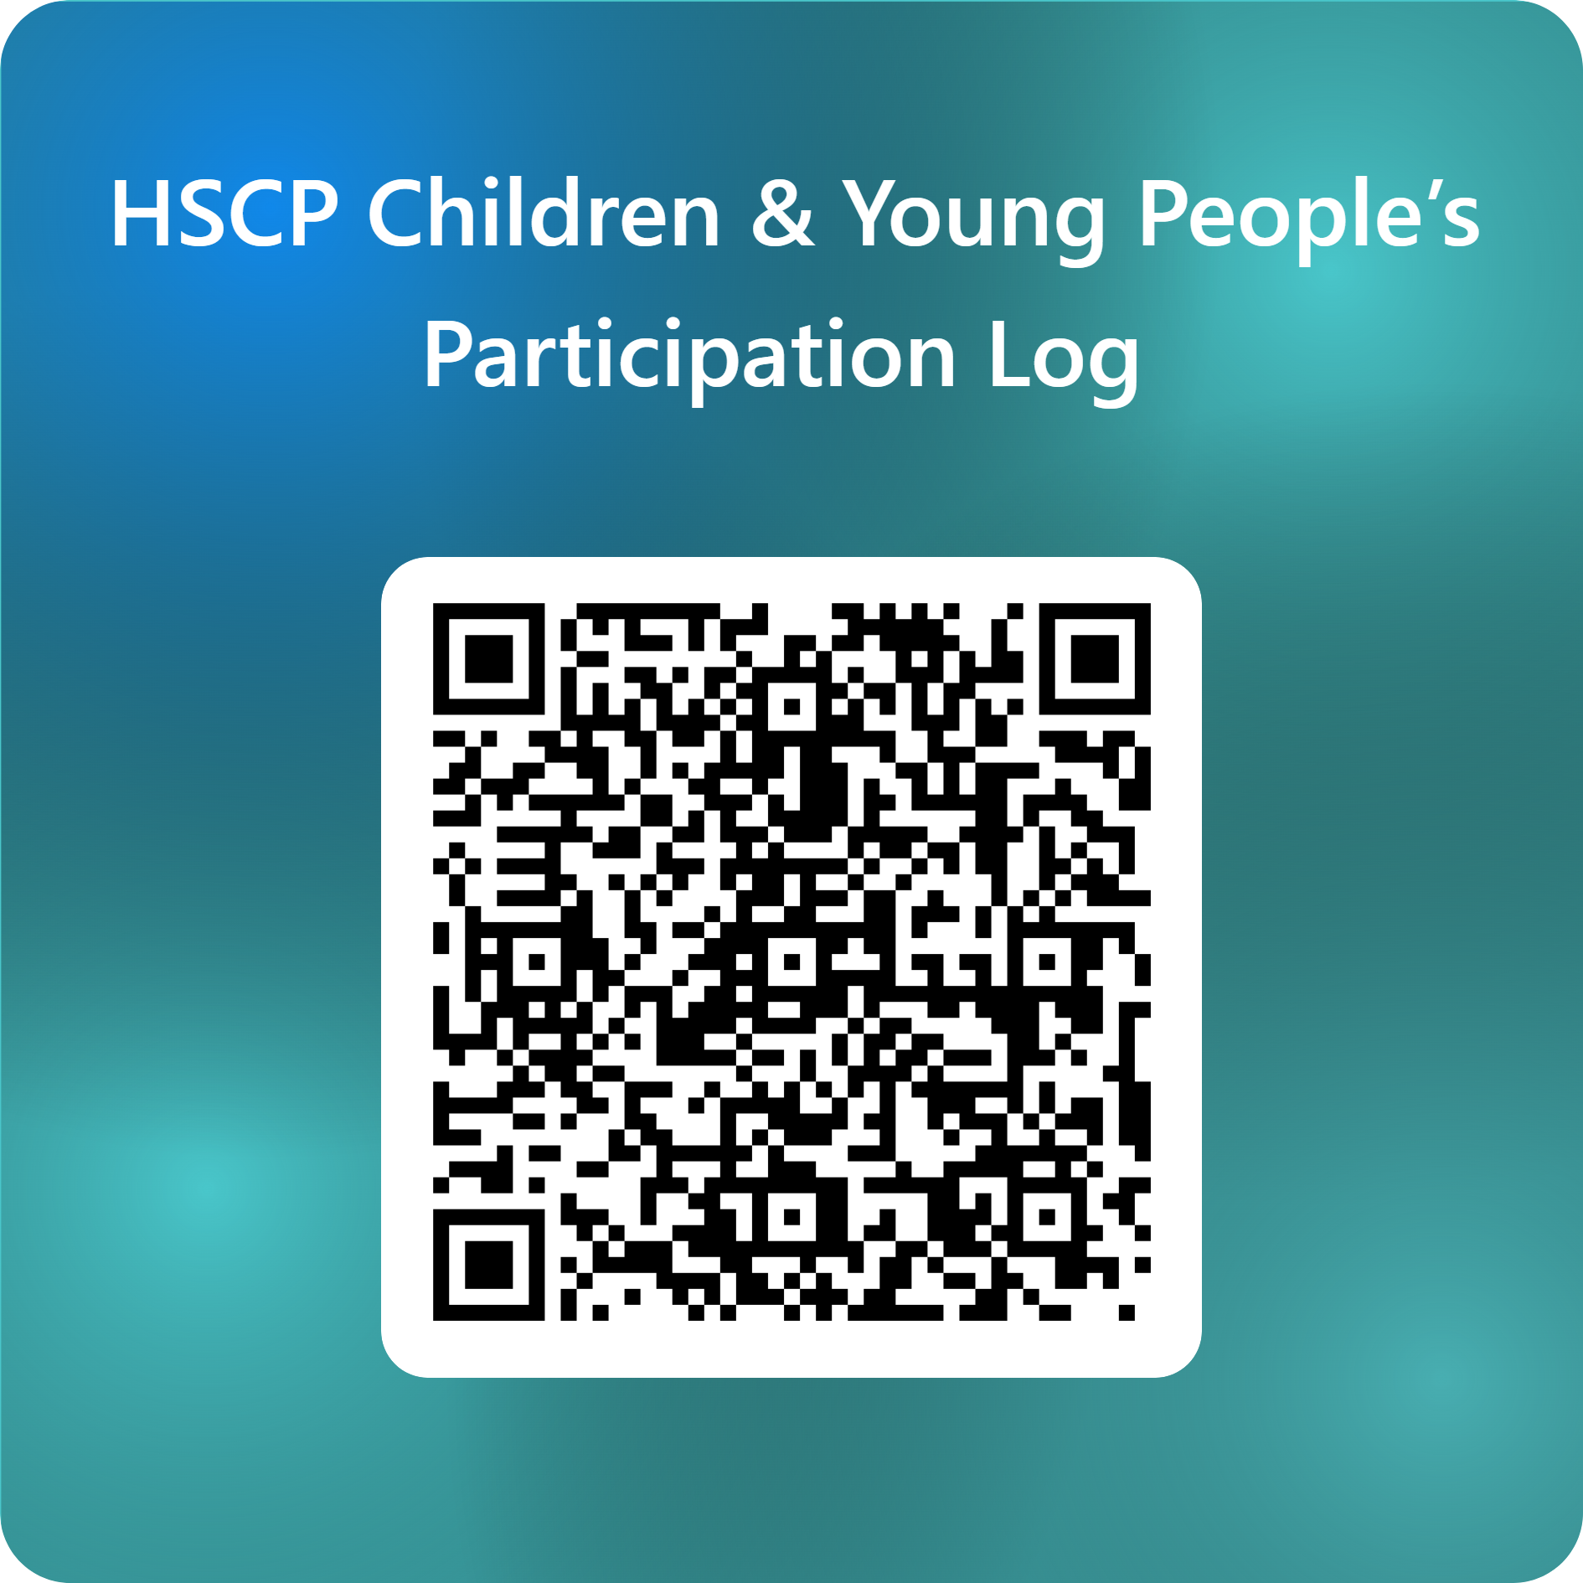
All staff across Halton Borough Council and partner agencies are asked to record the impact of children’s participation. The attached QR code links to a short form that should be completed after each participation activity.
Notes:
To support consistent recording of the impact of children’s participation, the attached QR code links to a simple form. Please complete this form each time participation work is carried out with children.

Slide 7
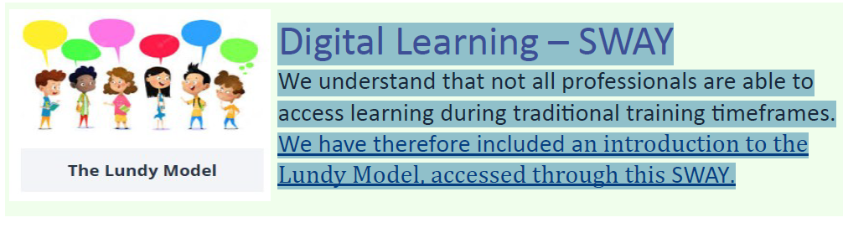
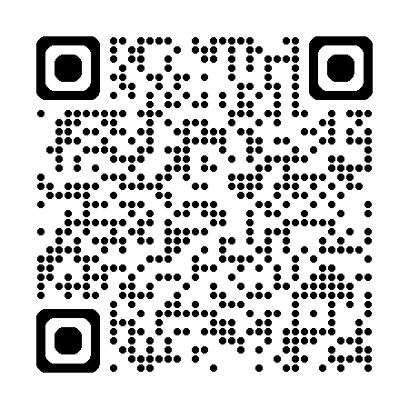
FURTHER INFORMATION
Halton Safeguarding Children Partnership provide information and training in The Lundy Model
Access this via the partnership website:-
Home - Halton Safeguarding Children
Notes:
Further information available at HBC Safeguarding Children Partnership website.
Please use this QR code for E-learning for The Lundy Model.

